Slide 1
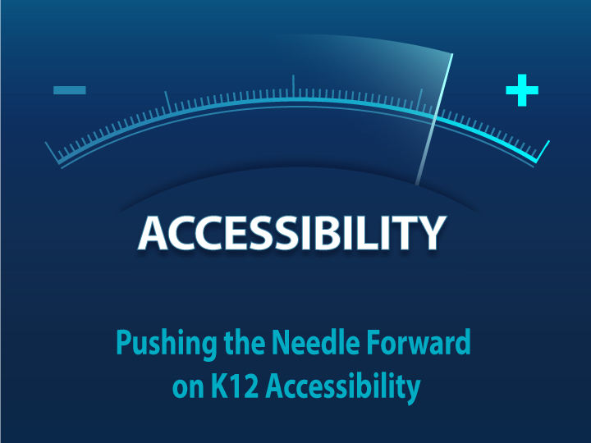
Pushing the Needle Forward on K12 Accessibility
Notes:
Cari Collins - Technology Design Coach, Austin ISD
Carye Edelman - Assistive Technology Specialist, Austin ISD
Shira Goldberg - Assistive Technology Specialist, Austin ISD
Sharon Krevor-Weisbaum, Esq., Managing Partner, Brown Goldstein & Levy
Jan McSorley - Accessibility at Pearson
Sharron Rush – Executive Director of Knowbility
Natalie Shaheen - Doctoral Candidate
Roger Steele - Technology Design Coach, Austin ISD
Extra Helpers:
Dan Brown – Senior Quality Assurance Engineer for Blindness Technologies
Desiree Sturdevant – Senior Quality Assurance Engineer for Blindness Technologies

Slide 2

Day at a Glance
Introductions
Panel
Break #1
Section 1
Lunch
Section 2
Break #2
Section 3
Wrap-up

Slide 3
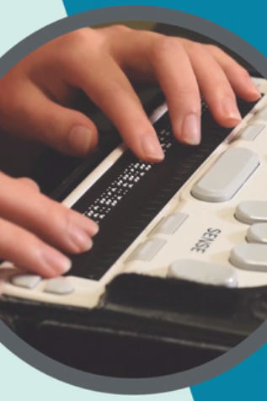
Introductions
John Slatin AccessU 2018
Cari Collins
Carey Edelman
Shira Goldberg
Sharon Krevor-Weisbaum
Jan McSorley
Sharron Rush
Natalie Shaheen
Roger Steele
Slides at:
http://accessibility.pearson.com/assessment/conferences/accessu2018.html
3

Slide 4
Panel Discussion
Notes:
Ben - Austin ISD
Diego - Austin ISD
Archer - University of Texas at Austin
Adelyn - Texas School for the Blind and Visually Impaired (TSBVI)
Robbi Cooper – Parent of student in Austin ISD
Evelyn Granger – Parent of student at TSBVI
Desiree Sturdevant – Parent with a visual impairment

Slide 5

Break #1 … 10:00 – 10:20
Time for a break
Notes:
Time for a break. Please be back here and ready to start by 10:20.

Slide 6
Section 1 10:20 – 12:00
Notes:
Panel Reflections
​Overview of disabilities
​Overview of assistive technology
Group activity #1: Have groups discuss what they learned and define who in a school district should be responsible for supporting students with disabilities:
Define the roles and why it would be important for those roles to be involved.

Slide 7

Panel Reflections
Notes:
Gather reactions about the panel
​Gather questions from the participants that they may have as a result of hearing the panelists' experiences​

Slide 8

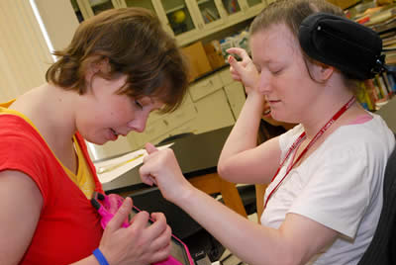
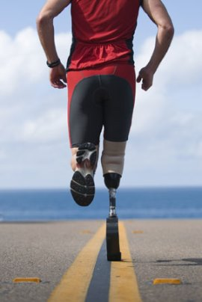

What is a Disability?
¹ The Merriam Webster dictionary defines a disability as a physical and/or mental impairment that limits movement, activities or the senses. It is estimated that about 10% of the civilian noninstitutionalized population aged 16 to 64 have a disability and 13.1 percent of school aged children have a disability (USED, 2016).
A disability can have a major impact on a person’s ability to learn, work, and perform daily activities. There are many different types of disabilities.
Disabilities can affect:
Hearing
Vision
Movement
Thinking
Remembering
Learning
Communicating
Mental Health
Social Relationships
Can affect:
Hearing
Vision
Movement
Thinking
Remembering
Learning
Communicating
Mental health
Social relationships
Notes:
¹ The Merriam Webster dictionary defines a disability as a physical and/or mental impairment that limits movement, activities or the senses. It is estimated that about 10% of the civilian noninstitutionalized population aged 16 to 64 ( ) had a disability and 13.1 percent of school aged children have a disability (USED, 2016).
A disability can have a major impact on a person’s ability to learn, work, and perform daily activities. There are many different types of disabilities. Some disabilities affective cognitive function while others impede physical function and/or sensory function.

Slide 9

World Bank Disability Statistics
15% of the world’s population has some form of disability
Adverse socioeconomic outcomes:
less education
poorer health outcomes
lower levels of employment
higher poverty rates
Notes:
According to the World Bank, approximately 15% of the world’s population has some form of disability … and
“[people] with disabilities, on average as a group, are more likely to experience adverse socioeconomic outcomes than [people] without disabilities, such as less education, poorer health outcomes, lower levels of employment, and higher poverty rates.”

Slide 10
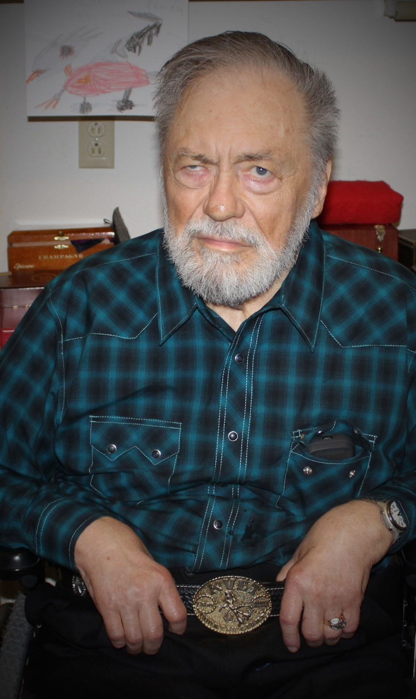
Dr. James L. Caldwell
People with disabilities constitute the largest minority group in the country, but this group differs from other minority groups in two important ways:
First, it’s the only minority group that anyone can join at any time.
Second, it’s the only minority group whose minority status can disappear by simply adapting the environment.
If people with disabilities can do what they want to do and what they need to do with the help of assistive technology or some other modification, then they are no longer disabled.
Notes:
Dr. Caldwell was in an accident when he was 25 that caused him to lose his vision and his ability to walk. He was told that he did not have any rehabilitative potential, but he went on to get his Ph.D. in business AFTER the accident and eventually worked as a software engineer for IBM until he retired. He has this to say about people with disabilities:
People with disabilities constitute the largest minority group in the country, but this group differs from other minority groups in two important ways:
First, it’s the only minority group that anyone can join at any time.
Second, it’s the only minority group whose minority status can disappear by simply adapting the environment.
If people with disabilities can do what they want to do and what they need to do with the help of assistive technology or some other modification, then they are no longer disabled.
Like Jim, 80% of people with a disability acquire it during a working age - Burkhauser, et al. 2014. Disability benefit growth and disability reform in the US: lessons from other OECD nations

Slide 11













IDEA 2004 14 Disability Categories
Orthopedic impairment
Deaf-blindness
Deafness
Autism
Orthopedic Impairment
Other Health Impairment
Deafness
Deaf-Blindness
Specific Learning Disability
Visual Impairment
Intellectual Disability
Developmental Delay
Hearing Impairment
Speech or Language Impairment
Emotional Disturbance
Traumatic Brain Injury
Multiple Disabilities
Other health impairment
Multiple Disabilities
Autism
Intellectual disability
Traumatic brain
injury
Visual impairment (including blindness)
Emotional disturbance
Hearing impairment
Developmental delay
Speech or language impairment
Specific learning disability

Slide 12
Two Primary Categories of Disabilities
*92.8% of students with disabilities
The two primary categories of disabilities are high incidence and low incidence.
According to the United States Department of Education’s IDEA, Part B data, in 2014-2015:
92.8% of students with disabilities have high incidence disabilities. This simply means that there is a higher level of precedence of these types of disabilities.
7.2% of students with disabilities have low incidence disabilities. This means that these types of disabilities are less common.
Low Incidence
High Incidence
*7.2% of students with disabilities
*According to IDEA Part B data 2014-2015 (USED, 2017)

Slide 13
Prevalence of Disabilities
According to the National Center for Education Statistics (NCES), “In 2015–16, the number of students ages 3–21 receiving special education services was 6.7 million, or 13 percent of all public school students. Among students receiving special education services, 34 percent had specific learning disabilities.”
(https://nces.ed.gov/programs/coe/indicator_cgg.asp)
2015-2016
Low Incidence
High Incidence
6.7 Million students, ages 3 – 21 received special education services.
(https://nces.ed.gov/programs/coe/indicator_cgg.asp)
Blindness
Low Vision
Deafness
Hard of Hearing
Deaf/blind
Orthopedic Impairments
Traumatic Brain Injury
Learning Disabilities
Speech and Language Impairments
Other Health Impairments
Autism
Intellectual Disability
Emotional or Behavioral Disorders
Notes:
Depending on the state you’re in, you may categorize disabilities differently, but this slide gives an example of the categories that disabilities may fall into.
This slide shows
According to the National Center for Education Statistics (NCES), “In 2015–16, the number of students ages 3–21 receiving special education services was 6.7 million, or 13 percent of all public school students. Among students receiving special education services, 34 percent had specific learning disabilities.” (https://nces.ed.gov/programs/coe/indicator_cgg.asp)

Slide 14
Assistive Technology
Notes:
Now we’re going to talk briefly about what assistive technology is and the trends that are happening with it in our schools.
The primary purpose of assistive technology, or AT, is to overcome the effects of a disability.

Slide 15
Legal Definition of Assistive Technology
IDEA defines an 'assistive technology device' as...
any item, piece of equipment, or product system, whether acquired commercially off the shelf, modified, or customized, that is used to increase, maintain, or improve functional capabilities of a child with a disability. (20 U.S.C. 1401(1))
IDEA defines an 'assistive technology service' as...
any service that directly assists a child with a disability in the selection, acquisition, or use of an assistive technology device.

Slide 16
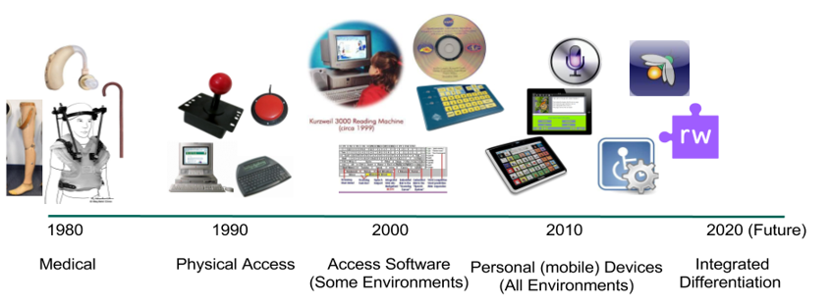
The “Expansion” of Assistive Technology
In 1980, we thought of AT mostly in terms of medical tools
In 1990, we started to think of assistive technology as a way to physically access computers
By 2000, we were looking at software solutions to help with access to some environments and,
By 2010 we were considering assistive technology software and hardware as a way to access all environments. Even so, we were still primarily looking at AT as a 3rd-party tool, used as an add-on to other tools.
But that concept is quickly becoming a thing of the past. As technology advances, we will be seeing more access tools being built into software and hardware as an integrated part of the design. This has been Apple’s business model for years. Their commitment to accessible design has made tools, like voice recognition, text-to-speech, and word prediction, common place. These tools, which started out as access solutions for people with disabilities, are now used by people with and without disabilities because of their ability to overcome environmental factors that can interfere with our use of technology.
Notes:
In 1980, we thought of AT mostly in terms of medical tools
In 1990, we started to think of assistive technology as a way to physically access computers
By 2000, we were looking at software solutions to help with access to some environments and,
By 2010 we were considering assistive technology software and hardware as a way to access all environments. Even so, we were still primarily looking at AT as a 3rd-party tool, used as an add-on to other tools.
But that concept is quickly becoming a thing of the past. As technology advances, we will be seeing more access tools being built into software and hardware as an integrated part of the design. This has been Apple’s business model for years. Their commitment to accessible design has made tools, like voice recognition, text-to-speech, and word prediction, common place. These tools, which started out as access solutions for people with disabilities, are now used by people with and without disabilities because of their ability to overcome environmental factors that can interfere with our use of technology.

Slide 17
Disability vs. Individuality
Notes:
Today we are going to challenge you think about disabilities in ways that you might not have thought about them before.
What did you see in the panelists? Did you see disabilities or did you see people who are capable of success, but through different pathways than other people might take?
We are going to challenge you think about disabilities being more a limitation of the environment than it is a limitation of the person.
The reason for this is that if we, as educators, can start to look at disabilities as a function of the environment, it will be easier for us to see how the environment limits everyone, not just those with diverse learning needs.

Slide 18
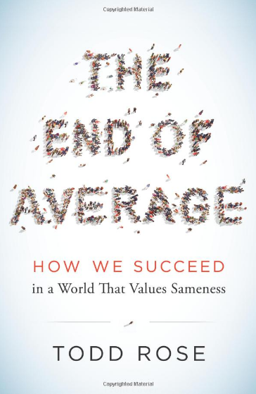
The Age of the Individual
Pathways Principle –
There are many, equally valid ways to reach the same outcome and the pathway that is optimal for one person is completely dependent on that person’s individuality.
Notes:
In his book Todd Rose, states that we are living in the Age of the Individual and he defines the Pathways Principle as:
… the way we recognize that there are equally valid ways of accomplishing something …
And … giving individuals the leeway to accomplish tasks in ways that are best suited to their skills.
This idea is one of the main reasons we are seeing an increased emphasis on Personalized Learning. Special Education has been personalizing learning for years, but now the benefits of flexibility and adaptability are being realized in mainstream education.

Slide 19

Individual Fit
Molenaar’s discovery about the flaw in using averages to understand individuals was not new.
In the late 1940’s, air force pilots could not control their planes. At its worst point, 17 pilots crashed in a single day.
Lieutenant Gilbert S. Daniels was assigned to help determine what was causing it. At the time, cockpits were designed for an “average-sized pilot,” but that average size had been calculated in 1926 by measuring hundreds of pilots at that time. Over the years, that average size had changed and the design of the cockpit was determined to be the source of the problem.
In 1952, Lieutenant Daniels concluded that, “The tendency to think in terms of the ‘average man’ is a pitfall into which many person’s blunder. It is virtually impossible to find an average airman not because of any unique traits in this group but because of the great variability of bodily dimensions which is characteristic of all men.”
Daniel’s analysis led him to the following conclusion: “Any system designed around the average person is doomed to fail.”
Discarding the average as their reference and standard, the air force adopted a new design philosophy called “individual fit.”
“When airplane manufacturers first heard this new mandate, they balked, insisting it would be too expensive and take years to solve the relevant engineering problems.
But the military refused to budge, and then – to everyone’s surprise – aeronautical engineers rather quickly came up with solutions that were both cheap and easy to implement.
They designed adjustable seats, a technology that is now standard in all automobiles.” They also created adjustable foot pedals, helmet straps and flight suits. Once the new solutions were in place, pilot performance soared.
Notes:
Mr. Rose gives an example in his book about how an inflexible environment led to disastrous results.
n the late 1940’s, air force pilots could not control their planes. At its worst, 17 pilots crashed in a single day, which made the excuse of pilot error seem very unlikely.
Lieutenant Gilbert S. Daniels was assigned to help determine what was causing the crashes. At the time, cockpits were designed for an “average-sized pilot,” but that average size had been calculated in 1926 by measuring hundreds of pilots at that time. Over the years, the average size of pilots had changed, so eventually, Lieutenant Daniels determined that the design of the cockpit was actually the source of the problem, and not pilot error.

Slide 20

Average Pilot
“Any system designed around the average person is doomed to fail.”
~Lieutenant Gilbert S. Daniels
Notes:
Daniel’s analysis led him to the following conclusion: “Any system designed around the average person is doomed to fail.”
He recommended that the cockpits and flight gear be designed to accommodate the needs of individual pilots by having adjustable features.
The air force referred to this as “individual fit.”
“When airplane manufacturers first heard of this new mandate, they balked, insisting it would be too expensive and take years to solve the relevant engineering problems.
But the military refused to budge, and then – to everyone’s surprise – aeronautical engineers rather quickly came up with solutions that were both cheap and easy to implement.
They designed adjustable seats, a technology that is now standard in all automobiles.” They also created adjustable foot pedals, helmet straps and flight suits. Once the new solutions were in place, pilot performance soared.
Today, the same companies that said it could not be done are touting the flexibility of their cockpits as a selling point.

Slide 21
“Individual Fit” was a practical solution to an urgent problem.
Why was the military willing to make such a radical change so quickly? Because changing the system was not an intellectual exercise – it was a practical solution to an urgent problem.”
Notes:
Individual Fit was a practical solution to an urgent problem.”
“Individual Fit” allowed for the cockpit to be personalized to the needs of the pilot.
Interestingly, this is precisely the role accessibility and usability play together in digital products.

Slide 22
Disability: More than a Health Problem
Complex Phenomenon Reflecting:
The interaction between features of a person’s body and
The features of the society in which he or she lives.
Notes:
In the same way, when we think about disabilities, we have to think about them as more than a health problem with a one-size-fits-all solution.
Disabilities are actually a reflection of the way a person’s body interacts with features of the society or environments in which he or she lives.
This means that under certain environmental circumstances, any person could have a disability

Slide 23
“Overcoming the difficulties faced by people with disabilities requires interventions to remove environmental and social barriers.” ~World Health Organization
Notes:
Understanding this means that we have to overcome the way we have typically thought about the design and use of educational products.
Students are learning in all kinds of environments, so now more than ever, we have to think about the effect of the environment on the ability of students to access information.
The World Health Organization recognizes this phenomenon and cautions that overcoming the difficulties faced by people with disabilities requires interventions to remove environmental and social barriers.
(Source: World Health Organization: http://www.who.int/topics/disabilities/en/)

Slide 24
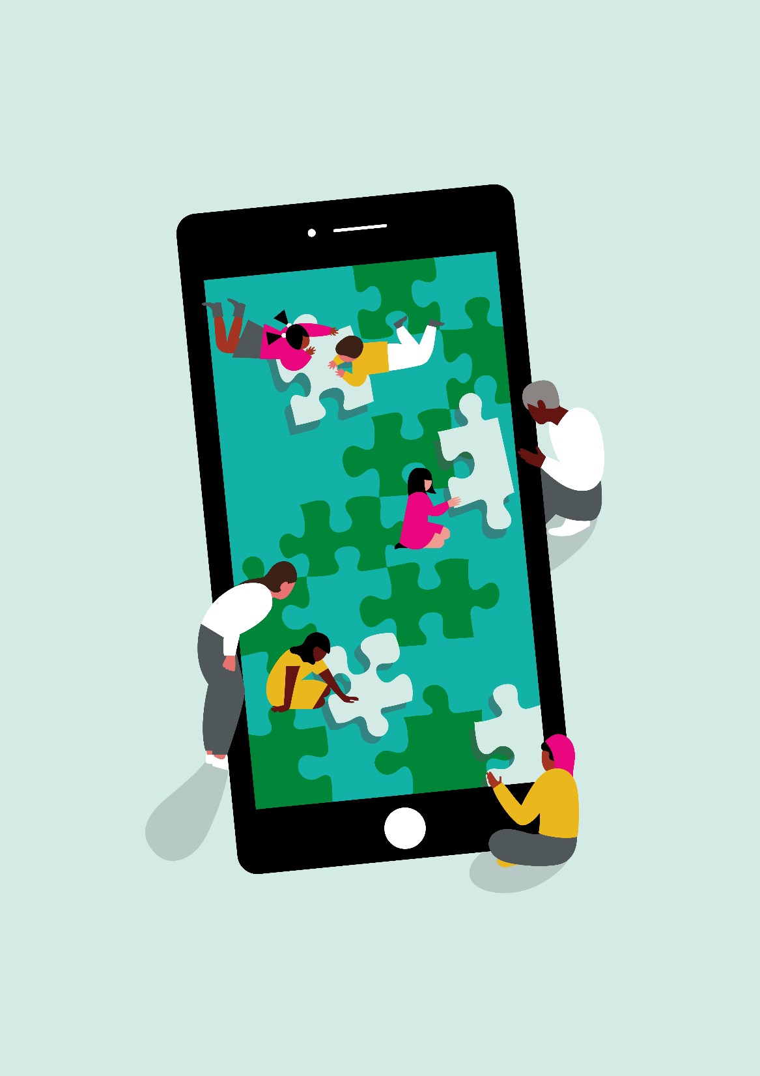
Group Activity #1
Discuss:
Panel
Overview of Disabilities
Trends in AT
Define:
What accessibility is
At least two take-aways that help you understand why accessibility is important
The roles in a school district that need to be involved in supporting accessibility

Slide 25
Lunch 12:00 – 1:00

Slide 26
Section 2 1:00 – 2:30
Notes:
Overview of accessibility
what is it and what are the standards that define it?​
What is the difference between AT, Accommodations, Modifications and Accessibility
Overview of accessible materials and technology systems
talk about why AT by itself is not enough Google Classroom, Google Things, LMS/CMS (AISD Canvas - called/branded “BLEND” at AISD)
State of the Union on laws affecting schools around digital accessibility - what are they; what legal activity is happening; what is the best approach schools can take to be prepared and to respond effectively if they receive a complaint, etc. (LMS systems and content in the systems - systems can break at different levels, state, district, teacher … at all points things can break (levels of ownership: teacher, procurement, etc.)

Slide 27
Is Access to Electronic Information a Human Right?
"...even where Internet connection is available, disadvantaged groups, such as persons with disabilities and persons belonging to minority groups, often face barriers to accessing the Internet in a way that is meaningful, relevant and useful to them in their daily lives.“
~Paragraph 61 of the special report of 17th session of the United Nations Human Rights Council

Slide 28
United Nations Resolution
July 5, 2012, the United Nations Human Rights Council unanimously agreed that access to the Internet is a basic human right and they signed a resolution to that effect.
"The motion was led by Sweden and supported by several other countries including America, Australia, Brazil, and the United Kingdom of Great Britain and Northern Ireland.

Slide 29
“It's the first ever U.N. resolution affirming that human rights in the digital realm must be protected and promoted to the same extent and with the same commitment as human rights in the physical world.”
~US Ambassador Eileen Donahoe

Slide 30
Accessibility is a Civil Right
In the United States …
Accessibility is a Civil Right:
American with Disabilities Act (1990)
Individuals with Disabilities Education Act (2004)
American Rehabilitation Act (1978)
Section 504 (equally effective access)
Section 508 (revised in 2017; revisions in effect January 18, 2018)
Notes:
In the United States, Accessibility is a civil right and there are several regulations in effect that address various components of access for people with disabilities.
We are not going to go into detail on these regulations, but Sharon will cover the legal landscape later in the presentation.

Slide 31
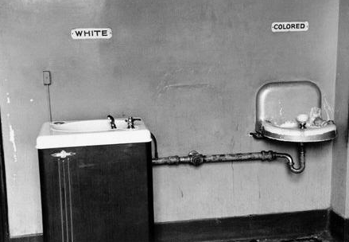
Civil Rights Movement for Racial Equality
On this slide, there’s a picture of separate water fountains from the days of racial segregation.
The water fountain for white people is nicer than the water fountain for people of color. This demonstrates the point of the civil rights movement and the efforts made to end segregation. There simply is no way to have separate, but equal services and this definitely holds true in education.
When we look back on the Civil Rights Movement for Racial Equality and we see images like this one, it does not stir up feelings of pride in our history, but instead it stirs up feelings of shame. It reminds us of a time when we devalued whole populations of people for simply having different colored skin – something that absolutely should never have been a measure of a person’s value.
Notes:
On this slide, there’s a picture of separate water fountains from the days of racial segregation.
The water fountain for white people is nicer than the water fountain for people of color. This demonstrates the point of the civil rights movement and the efforts made to end segregation. There simply is no way to have separate, but equal services and this definitely holds true in education.
When we look back on the Civil Rights Movement for Racial Equality and we see images like this one, it does not stir up feelings of pride in our history, but instead it stirs up feelings of shame. It reminds us of a time when we devalued whole populations of people for simply having different colored skin – something that absolutely should never have been a measure of a person’s value.

Slide 32
More than a Digital Divide …
Notes:
With respect to equality for people with disabilities, we have a situation in many of our schools that is far more serious than a digital divide.
Even though accessibility is a civil right, that does not mean that it is a reality in the lives of people with disabilities.
If we are going to make the changes that are necessary to make, we have to understand the severity and urgency of the problem we are trying to solve.

Slide 33
Dr. Dave Edyburn University of Central Florida
“Whereas inclusion has provided access to the general education classroom, there is little evidence to indicate that students with disabilities have been provided with equally effective access to the general curriculum.”
Notes:
Dave Edyburn explains what is happening in our schools in terms of access to the general curriculum

Slide 34

Digital Segregation
Technology is often driving what happens in education.
The term “innovation” is often equated with “new.”
Students with certain types of disabilities cannot get through the front door of our technology systems and therefore are digitally segregated from other learners.
Notes:
Right now, the reality is that the pace of technology is often driving what happens in education, rather than education making systematic, thoughtful decisions about how best to use technology.
The term “innovation” is often equated with “new” and time is not always taken to evaluate the efficacy and accessibility of the tools we use in our classrooms.
The result is that students with certain types of disabilities cannot get through the front door of our technology systems and therefore are digitally segregated from other learners.
Right now we have an opportunity to write our history where this issue is concerned.
Will we look back on this time as a time when equally effective access was the priority in our schools, or
Will we remember this as a time when people with disabilities were marginalized in the name of innovation?

Slide 35
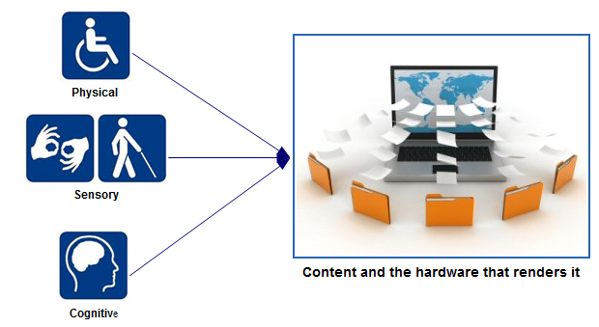
Access to Digital Learning & Assessment
Notes:
In terms of access to digital content, people may experience physical, sensory or cognitive barriers.

Slide 36
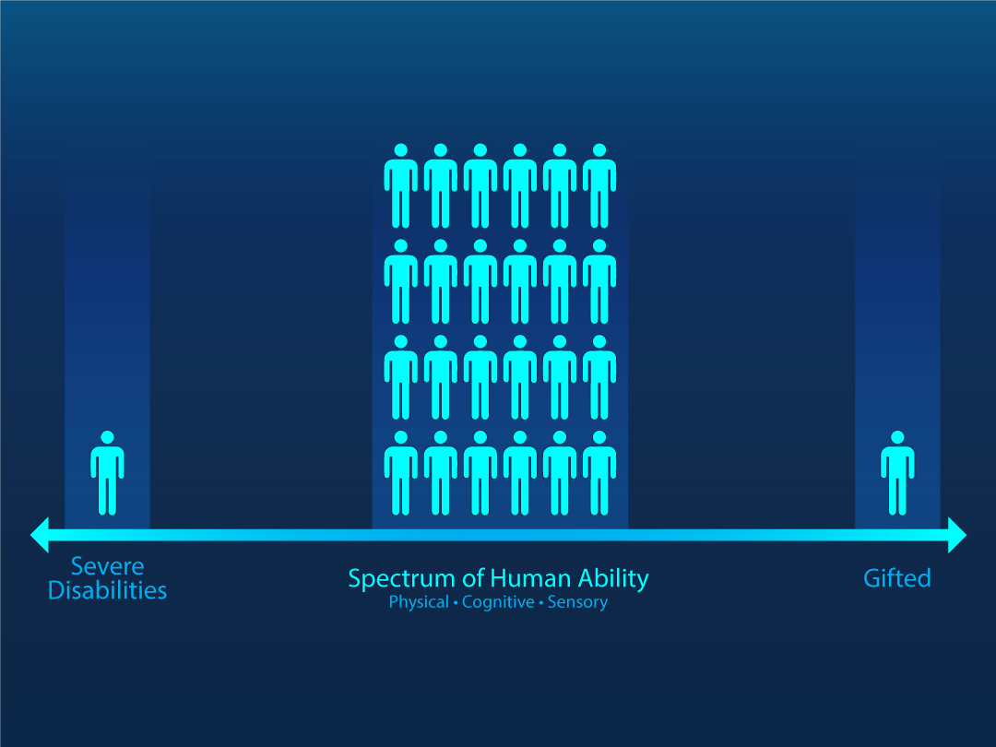
Changing the way we think
without an understanding of how varied human ability can be, it can be tempting to think of our end users as falling into “distinct buckets of need,” that are placed along a linear spectrum of human ability.
If designers and developers think in this way, they will tend to design products that meet their personal abilities and assume that the majority of people can interact with content and complete tasks in the same way THEY do.
This type of thinking actually leads to the assumption that people with diverse needs constitute a small population and that if we design for them, we won’t get a return on our investment.
Notes:
This slide shows a line with arrows on either end. The line represents the spectrum of human ability, ranging from severe disabilities on the far left to gifted on the far right.
There is a tendency to think that most people are average and that if we design everything for the largest number of people in the middle, that we can just make some adjustments to meet the needs of people on either end of the spectrum because there aren’t that many people who are actually different.

Slide 37
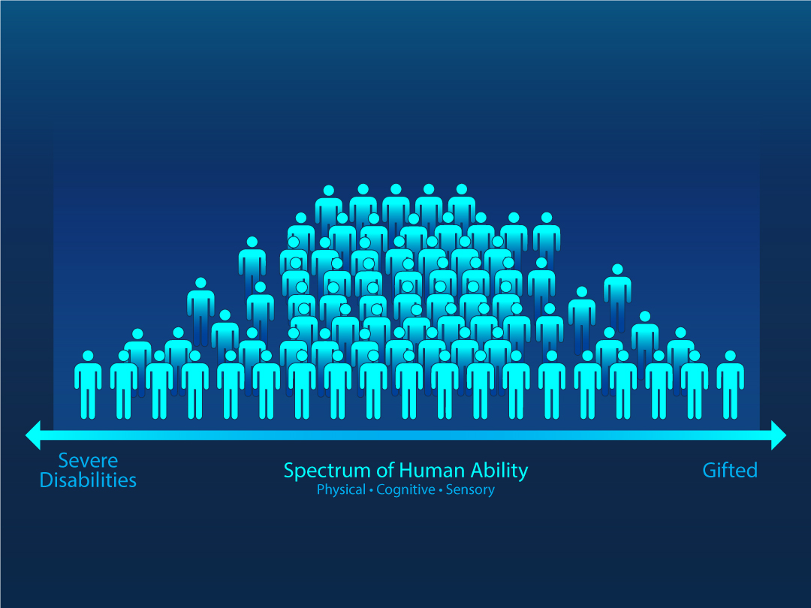
Changing the way we think
The majority of people do not fit neatly into an average user bucket along an ability spectrum. Peoples’ abilities are actually spread all over the three spectrums of physical, sensory and cognitive impairments, with many people falling somewhere between the mythical average bucket and the more extreme ends.
Notes:
In reality, the majority of people do NOT fit neatly into average user buckets along an ability spectrum. Peoples’ abilities are actually spread all over the three spectrums of physical, sensory and cognitive abilities … with many people falling somewhere between the middle and the more extreme ends.
Just as on the previous slide, this slide shows a horizontal line labeled, “Spectrum of Human Ability “ with arrows on each end of the line.
However, rather than showing the human icons as being partitioned into buckets, the icons are instead spread across the line to illustrate that people cover the entire spectrum of human ability. If we try to force people into buckets we will actually be less innovative and less flexible and therefore miss meeting the needs of people who fall between the middle and the extreme ends.
If, however, we consider diverse needs in the design and implementation of digital tools, those tools will be more flexible and adaptable to personalized needs.
This will lead to the expansion in the number of people who can use the tools efficiently to meet their educational and vocational goals.
And … just to make things more interesting, all people have varying levels of ability in all three categories of Physical, Sensory, and Cognitive abilities.
At any given moment in a person’s life, they can function at various levels of ability across the physical, sensory, and cognitive spectrums of ability.

Slide 38
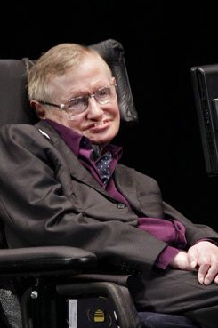
Combinations of Abilities & Impairments
Visual impairment
Multiple physical impairments
Cognitively Gifted
Notes:
As an example:
Stephen Hawking had multiple impairments, but he was only disabled when his environments made him so. Without a power wheelchair custom-designed to meet his needs, he was not able to move independently. Without an augmentative communication device, his instantaneous communication would have been severely limited.
However, when his environments were flexible enough to accommodate the tools he used for mobility, speech, and vision, then he was able to do what he wanted to do and what he needed to do by using those tools.
Stephen Hawking had a visual impairment, as evidenced by the fact that he wore glasses. He also had multiple and significant physical impairments that impacted his ability to walk, use his hands, and speak.
Despite his physical and sensory challenges, … he was a brilliant scientist who would be considered on the gifted end of the cognitive abilities spectrum.

Slide 39
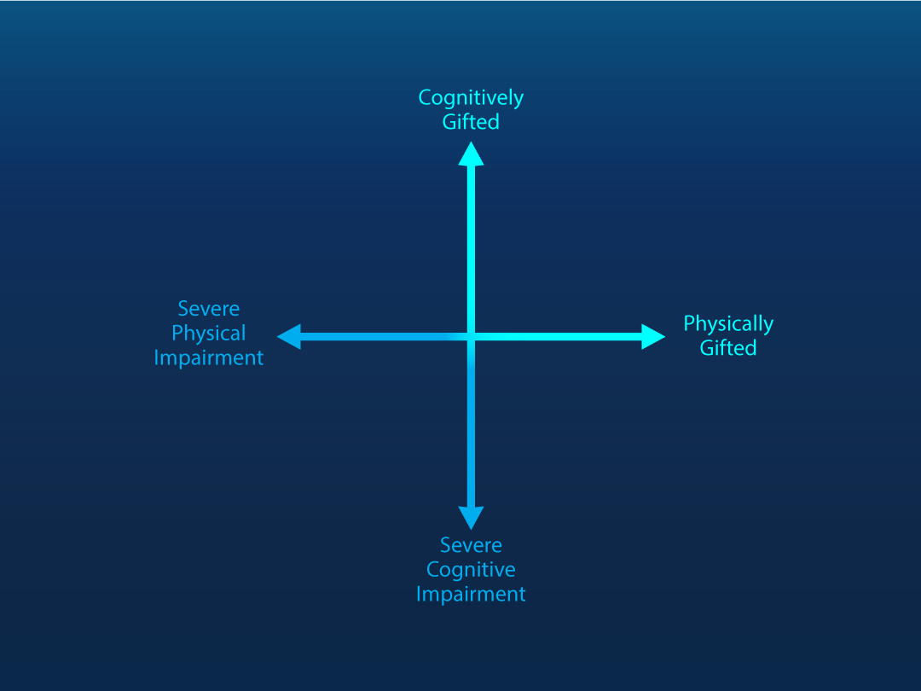

Graphing Stephen Hawking’s Physical and Cognitive Abilities
To illustrate this further, when thinking about Stephen Hawking’s impairments, let’s take a minute to consider the two spectrums of Physical and Cognitive Abilities.
On the screen we show a graph with Physical Abilities along the x-axis, with arrows on each end, pointing to the left and to the right
Cognitive Abilities are indicated along the y-axis, with arrows on each end, pointing toward the top and bottom.
Physical impairments are indicated on the left side of the x-axis with the more severe impairments on the far left side.
Physical abilities are on the right side of the x-axis with physically gifted on the far right side.
Cognitive abilities are indicated on the y-axis, above the x-axis, with cognitively gifted being at the top.
Cognitive impairments are indicated on the y-axis, below the x-axis, with severe cognitive impairments being at the bottom.
If we were to place a human icon on this graph to represent Stephen Hawking, it would be located in the far-upper-left corner to indicated severe physical impairments and cognitively gifted.
Notes:
To illustrate this further, when thinking about Stephen Hawking’s impairments, let’s take a minute to consider the two spectrums of Physical and Cognitive Abilities.
On the screen we show a graph with Physical Abilities along the x-axis, with arrows on each end, pointing to the left and to the right
It is intersected in the middle by the y-axis, which indicates Cognitive Abilities. Just like the x-axis, the y-axis has arrows on each end, pointing toward the top and the bottom.
Physical impairments are indicated on the left side of the x-axis with the more severe impairments on the far left side
Physical abilities are on the right side of the x-axis with physically gifted on the far right side.
Cognitive abilities are indicated on the y-axis, right above the x-axis, with cognitively gifted being at the top.
Cognitive impairments are indicated on the y-axis, below the x-axis, with severe cognitive impairments being at the bottom.
If we were to place a human icon on this graph to represent Stephen Hawking, it would be located in the far-upper-left corner to indicate severe physical impairments and gifted cognitive ability.

Slide 40
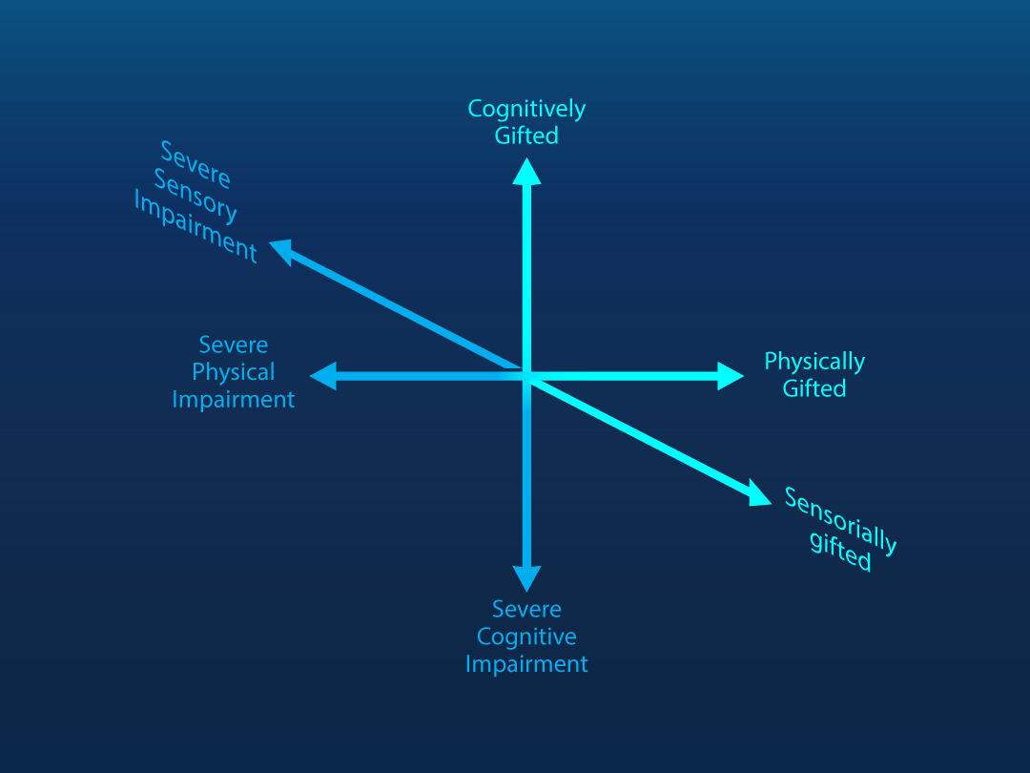
Graphing Physical, Sensory, and Cognitive Abilities of multiple users
Just like Stephen Hawking, users of our products will have abilities that will fall across the three spectrums of physical, sensory, and cognitive abilities….
The graph on this slide shows an intersection of these three spectrums to illustrate the variability in human abilities.
No two people will be at exactly the same spot for all three spectrums.
As a matter of fact, I feel fairly certain that everyone listening to this session considers him or herself to be different in their physical, cognitive, and sensory abilities when compared to other people … and EVEN different when compared to a version of their younger selves.
Remember, Stephen Hawking’s impairments are a result of a degenerative illness, so when he was younger, he had abilities that he does not have today.
The point here is that everyone is unique and their needs can and will change over time and according to their environments.
Notes:
Just like Stephen Hawking, students in K12 will have abilities that will fall across the three spectrums of physical, sensory, and cognitive abilities….
The graph on this slide shows the intersection of these three spectrums with lines, similar to the previous graph. This is done to illustrate the variability in human abilities.
No two people will be at exactly the same spot for all three spectrums.
As a matter of fact, I feel fairly certain that everyone thinks of him or herself as being different in their physical, cognitive, and sensory abilities when compared to other people … and EVEN different when compared to a version of their younger selves.
Remember, Stephen Hawking’s impairments were a result of a degenerative illness, so when he was younger, he had abilities that he did not have later in life.
The point here is that everyone is unique and their needs can and will change over time and according to their environments.

Slide 41
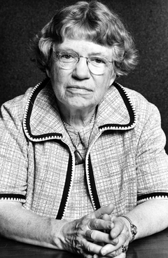
Always remember that you are absolutely unique.
Just like everyone else….
~Margaret Mead
Notes:
As Margaret Mead once wisely said, “You are absolutely unique … just like everyone else.”

Slide 42

Pitfalls of the Single Solution Mentality
Making assumptions leads to failure and the swinging of the proverbial pendulum.
Notes:
Even though we know better, it’s human nature to look for the silver bullet – the one solution that will solve all of our problems. As expected, when we try to apply single solutions to diverse needs, the results are less than satisfactory.
Anyone who has been in education for any length of time knows about the phenomenon of the swinging pendulum.
The primary cause of pendulum swinging is rooted in assumptions. When we make assumptions, we make mistakes.

Slide 43
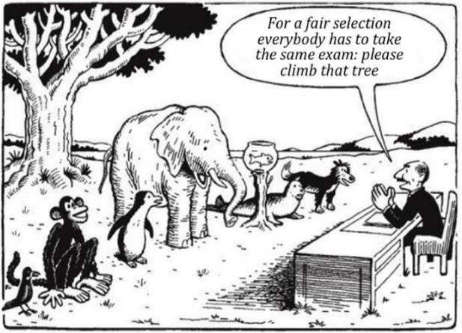
Excluded by Design
Our long-term focus on comparing everyone to an “average student” led education companies to design products and services for students with:
Average Vision
Average Hearing
Average Motor Abilities
Average Cognitive Abilities
Notes:
On this slide, there is a man sitting at a desk. Several different types of animals are standing in a line in front of the desk with a tree behind them. There is a bird, a monkey, a penguin, an elephant, a fish in a fish bowl, a seal, and a dog. The man is telling the animals that “For a fair selection, everybody has to take the same exam. Please climb that tree.“ The monkey looks really happy because he can climb the tree without any problem, but for everyone else, the bird included, it is not going to be possible to “climb” the tree.
Whether we want to admit it or not, students with needs that diverge from the mythical average student have historically been excluded by design.
When, for whatever reason, designers and developers don’t consider the full range of diverse needs that users have, the unintended consequence is that students who don’t meet the mold are excluded from educational or vocational opportunities, simply because products and services are not designed to be accessible and are therefore inflexible and unable to be adapted to the needs of the user.

Slide 44

Cereal Aisle with Multiple Selections
Notes:
In almost every aspect of our lives, we are given choices.
On this slide, you see a picture of cereal boxes in a grocery store.
There is a wide variety of choices because the store owner knows that people want to choose which cereals they eat.

Slide 45
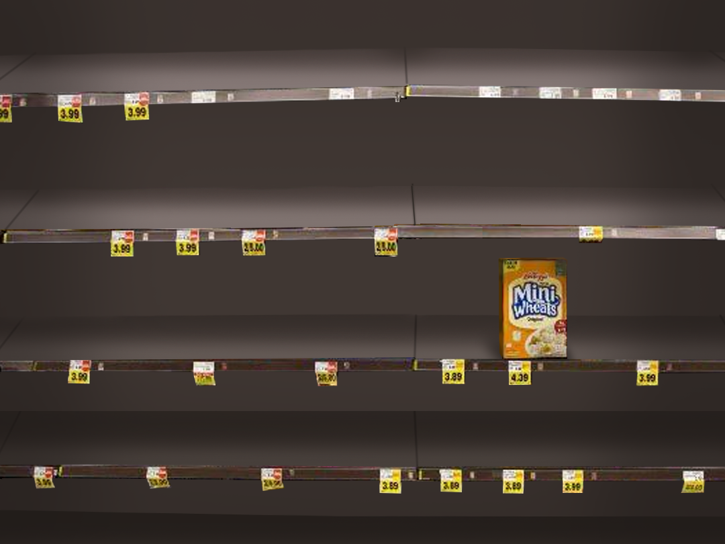
Reduced to one option
Cereal isle with only one cereal selection.
Notes:
What would it make you feel like if the store owner decided that he or she knew what was best for you and only offered you one kind of cereal?
You probably wouldn’t shop there any more.

Slide 46
Everyone is affected by situations and environments, which is why choice and flexibility are important in the tools we use.
Notes:
Unfortunately, when we make the same kinds of singular decisions for students, they often don’t have the luxury of choosing a different school.
With the influx of personal devices in school and access to content being provided on mobile devices, the educational environments in which students are learning are no longer limited to brick and mortar schools.
Students are learning on buses, at parks, in their bedrooms, and on their bicycles.
They are learning outside and inside, in sunny environments and in the shade; in well-lit rooms and in rooms with limited lighting.
We no longer have the luxury of limiting access to controlled environments, which is why choice and flexibility are important in the tools we use.
We have to take into account that disabilities are a consequence of the environments we all find ourselves in

Slide 47
Everyone means Everyone
Permanent Impairment /
Person with a Disability
vs.
Situational Impairment /
Person without a Disability
Notes:
With that idea in mind, let’s review some common accommodations for people with permanent impairments that can also be helpful to people who may find themselves in situations that temporarily impair their normal abilities.

Slide 48

Physical Barriers
Curb cuts
Alternative mice
Word prediction
One-handed / one-finger use of mobile devices
Voice recognition
Motorized wheelchairs
Notes:
For physical impairments:
Curb cuts are used by people in wheelchairs,
but also by people with luggage, baby strollers, dollies, etc.
Alternative mice may be necessary for people with severe fine motor deficits,
but can also benefit people with repetitive motion injuries.
Word prediction software can increase the typing speed and accuracy of people with physical or learning impairments,
but can also support people who are texting and are not able to pay close attention to the accuracy of their typing.
One-handed or one-finger use of mobile devices occurs with people who have varying motor impairments,
but also occurs with people who are carrying babies, groceries, or who are on public transportation and are standing and holding onto a rail with one hand.
Voice recognition may be used by people with varying levels of paralysis,
but can also be used by people who are driving or who have temporary injuries to their hands due to accidents or surgeries.
Motorized wheelchairs are used by people with significant motor impairments, such as cerebral palsy,
but can also be used by people who have temporary, but significant motor impairments, due to severe injuries or long-term disease.

Slide 49


Sensory Impairments
Captions on media
Transcripts of media or live events
Portable word processing or mobile devices
High Contrast
Pinch-Zoom
Text-to-Speech (TTS)
Haptic vibration
Notes:
For Sensory Impairments:
Captions are used by people who are deaf or hard of hearing,
but they are also used by people who may just want to make sure they don’t miss dialog in a movie due to actors with heavy accents or poor audio;
they are also useful to people wanting to access audio in noisy environments, or in environments that are intolerant of excessive noise, such as libraries or places of employment.
Transcripts are used by people who are deaf or hard of hearing, as well as people with visual impairments in order to get details about audio-visual material,
but they are also used by people who may not have time to watch an entire video, but instead need to skim through a transcript to cover the basic concept,
or … maybe they are in an environment that is intolerant of noise, but they still need to consume the content of the video.
Portable word processing devices and mobile phones are used by people who are deaf to communicate via text with people who are hearing. This technology can be used to conduct business, such as buying a car or selling insurance and it benefits people on both sides of the communication.
High Contrast between the text and background colors is important for people with certain types of visual impairments,
But it is also helpful to people who are using their mobile devices in the sun, or who are using them in a mode to preserve battery power
Pinch-Zoom is useful for people with limited vision,
but it is also helpful to people with normal vision or mild visual impairments who need to see details on a map, read a menu in less-than-ideal lighting, or who may be trying to read very small print on a medicine bottle.
Text-to-speech is necessary as a feature of screen readers used by people who are blind to navigate and interact with information auditorally. It is also very helpful for people with vision who have reading disabilities, such as dyslexia that might affect their ability to decode words.
but is also useful to people who want to listen to books while they drive, or for students who want to read their homework assignments while doing laundry or riding their bikes to class.
Haptic vibration is essential for people who are deaf AND blind and need a way to be alerted to phone calls, texts or to emergency situations, such as fire alarms.
But haptic vibration is also used by people who are in noise-intolerant situations or in noisy environments where it is difficult to hear a phone ring and are therefore situationally impaired and need a different way to receive communication alerts.
We are also starting to see haptic feedback technology built into automobiles as a safety precaution that alerts drivers when they are veering too close to obstacles on either side of the car.

Slide 50

Cognitive Impairments
Adjustable brightness
Single-column layout
Simplified language
Phonetic spellcheck
Electronic dictionaries
Simplified user interface
Save personal information
Notes:
For Cognitive Impairments:
Being able to adjust the brightness on displays helps people with various types of perception issues. Some people with dyslexia do not do well with bright overhead lighting or with bright lighting on a device and being able to adjust or change the lighting can help them when they have to interact with printed text.
Adjusting the lighting on a device can also help people conserve battery or see the device in different environments where lighting may fluctuate.
Single-column layout can benefit people with a variety of cognitive impairments, including autism.
It can also be helpful to the person who’s computer just crashed and now they have to read a 90-page school assignment on nothing but a small mobile device.
Simplified language can help people with different types of cognitive abilities,
but it can also support second-language learners, or people who are in a hurry or are multi-tasking; plain language is also easier to translate into different languages than complex language.
Phonetic spell checkers and electronic dictionaries support the writing needs of people with varying levels of dysgraphia,
but they also support second-language learners with writing and language acquisition.
Additionally, electronic dictionaries can be useful to people who are simply reading for pleasure on an eReader and come across an unfamiliar word.
A simplified user interface, and the ability to save identifying data into a system once so that it doesn’t have to be entered multiple times, … is very important to people with certain types of cognitive impairments, such as Traumatic Brain Injury,
but it is also helpful to people who may be extremely fatigued, or may be multitasking and are therefore situationally, cognitively impaired.

Slide 51
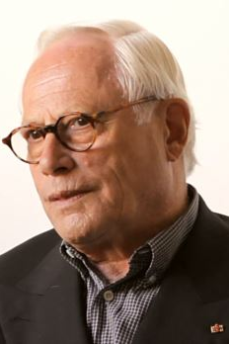
Dieter Rams
“Indifference towards people and the reality in which they live is actually the one and only cardinal sin in design.”
Notes:
Dieter Rams is a legendary German designer who is credited with saying that “Indifference towards people and the reality in which they live is actually the one and only cardinal sin in design.”

Slide 52
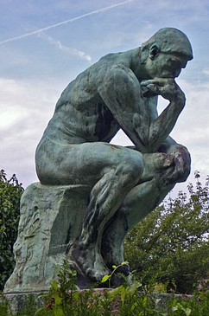
Thought Experiment
Thought Experiment: If you were on a computer and needed to go to the Knowbility website to search for information about AccessU, how would you do that?
Could you perform the same task on your computer without a mouse?
Without a keyboard?
Without a monitor?
Your input AT: Mouse, keyboard
Other Input AT: Switch, voice, alternative keyboard
Your output AT: Monitor
Other output AT: Speakers, Braille display
Notes:
Thought Experiment: If you were on a computer and needed to go to the Knowbility website to search for information about AccessU, how would you do that?
Could you perform the same task on your computer without a mouse?
Without a keyboard?
Without a monitor?
Your input AT: Mouse, keyboard
Other Input AT: Switch, voice, alternative keyboard
Your output AT: Monitor
Other output AT: Speakers, Braille display

Slide 53
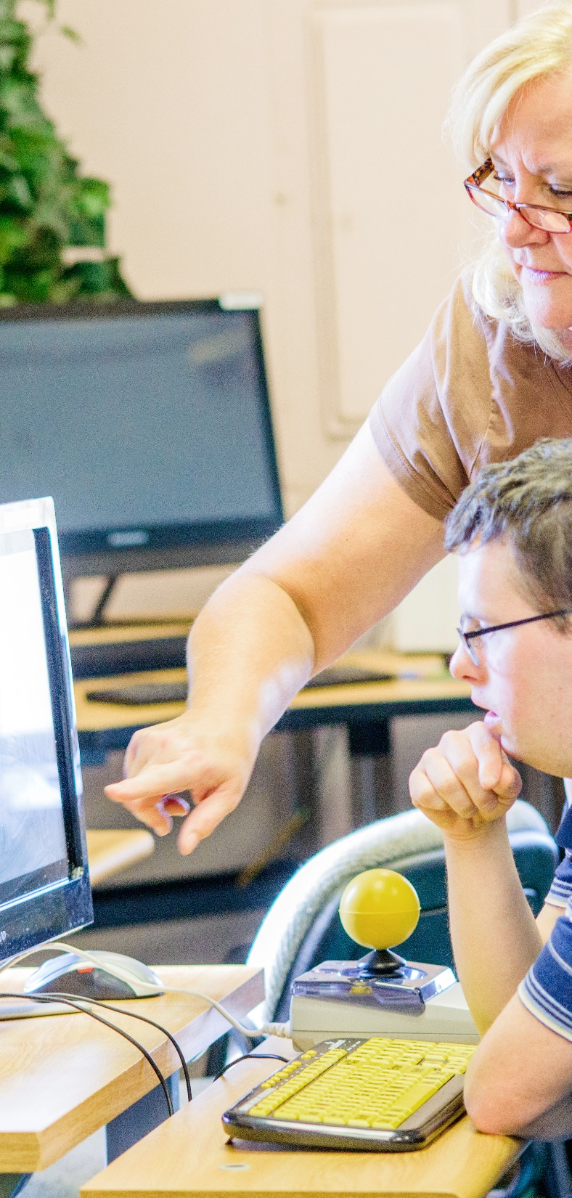
Some Barriers to Digital Content for People with Disabilities
Navigation and item interaction
Keyboard only users
Compatibility with assistive technologies
Lack of color contrast and focus identification
Physical / Sensory fatigue
Cognitive Overload
Limited access to content in multiple formats
Text & Equations presented as images
Ineffective or nonexistent alternative text
Lack of randomized access
Notes:
So let’s review some of the primary barriers to accessing digital content for students with disabilities:
One of the primary access barriers has to do with navigation and item interaction. Every digital product needs to take into account that there may be people accessing that content who cannot use a mouse.
Another primary barrier is a lack of color contrast and visual focus. It is important that the foreground and background colors have enough contrast to accommodate various types of visual needs. The Web Content Accessibility Guidelines states that the contrast minimum should be a ratio of 4.5:1 for normal text against its background.
Visual focus means that the user should be able to see where they are on the screen. If you’ve ever been on a browser and used your tab key, you might have seen a pale dotted line around items as you tabbed through the page. That is an example of visual focus. It is allowing a person who is not a mouse user to see where they are in terms of navigating the page so that when they get to something they want to interact with, they can select it and complete the action they want to complete.
People with disabilities can be subject to physical and/or sensory fatigue, as well as cognitive overload. If content is difficult to see, people with certain types of visual impairments may experience eye fatigue that can cause pain and can actually cause their vision to worsen until they are able to rest their eyes.
People with severe motor impairments may have poor fine motor control, so accessing a computer may require a lot of gross motor use that can cause them to become physically exhausted.
The way content is written and the layout of content can also lead to cognitive overload. Plain language with well-constructed grammar and simple sentences should be used as often as possible. It is also important to have adequate white space to help users consume the content in logical chunks.
The general goal of accessible design is to give users with disabilities the same kind of randomized access to content that people without disabilities are able to have.

Slide 54
Digital does not necessarily mean accessible.
Notes:
Just because something is delivered through a digital format, does not mean that it’s accessible.
Accessibility comes through purposeful design.

Slide 55

Ubiquitous Access to Information
More Digital Content
Electronic Text
Web Content
Mobile Devices
1-to-1
Bring your own
Custom Curriculum
Cloud data storage
Computer-based assessments
Notes:
The most common definition of accessibility is “ubiquitous access,” which means that it is available on the web, 24 hours a day, 7 days a week. People also define access in terms of format – can I get access to an electronic version of the text or is the text on the web? We also expect to have access on our mobile devices and many schools are implementing 1:1 programs or bring your own device programs.
These programs are usually designed to ensure that students have equipment that they can use to access customized curriculum that the schools may have designed themselves.
Data is also a big consideration when talking about access – schools are interested in making sure that student data can saved and that their student information systems are compatible with digital content.

Slide 56

It’s so much more…
Foundational to Universal Design
Flexible materials and resources
Adaptable to unique learner needs
Supports personalized learning
Meets regulatory standards, including accessibility standards
Is interoperable with other technologies
Adds value to the learning experience
Notes:
While all of those definitions about access are true, access is actually much more than that. When products and services are designed with the needs of people with disabilities in mind from the beginning, it makes them more effective for everyone. Accessible design is foundational to Universal Design. You cannot have a universally designed product that categorically denies access to whole populations of people.
Materials that are designed to be accessible to people with disabilities are more flexible and adaptable to unique learner needs. For this reason, accessible materials support personalized learning and personalized assessment better than materials that are inaccessible.
Following standards-based accessible design practices will also support efforts to meet regulatory and interoperability standards
But most importantly, accessible design adds value and gives you a competitive edge in the market.
Pearson has an opportunity and we are literally at a crossroad. Accessibility is encoded into law in over 60 countries. It is not going away, so Pearson can either choose to lead in this area and make accessibility part of our core value and brand, or we can be like other companies who are going to wait for lawsuits to get them to act.
What do you think will look better from an historical perspective? A story that shows Pearson only acting on accessibility under the threat of litigation, or a story that shows Pearson living up to its espoused values and prioritizing accessibility as a cornerstone of its brand? History will be written one way or the other and our choices now will drive how it is written.

Slide 57

Universal Design for Learning (UDL)
Representation
Universal Design has 3 principles that work together to support access for student learning. The first principle is representation which is how the information is presented. The second is action and expression which gives students alternatives to pencil and paper to express the knowledge on a subject and the third is engagement which stimulates student interest by providing learning in a variety of ways. It is important to note that it might not be feasible to incorporate all three principles into every lesson every time. Rather, they are intended to guide instruction over time. Even when teachers apply the three principles, some students may need additional support. Consequently, teachers will sometimes have to make accommodations (e.g., allow the use of a spell checker) to meet an individual student's needs.
The important thing about UDL is that is supposed to be done BEFORE designing the lesson.
Written into ESSA
It’s a principle
It is NOT a standard
Engagement
Action and Expression
Notes:
As many of you know, Universal Design for Learning (or UDL) is mentioned in the Every Student Succeeds Act (ESSA), 8 times.
There are 3 principles in UDL that work together to support access for student learning.
The first principle is “representation” which is how the information is presented.
The second is “action and expression” which gives students alternatives to pencil and paper to express their knowledge on a subject and
The third is “engagement,” which stimulates student interest by providing learning in a variety of ways.
These principles are intended to guide instruction over time, but even when teachers apply the three principles, some students may need additional support.
UDL, by itself, is not sufficient to meet the needs of all learners, but when built on the foundation of accessibility where the needs of all learners are considered, UDL is far more effective.

Slide 58
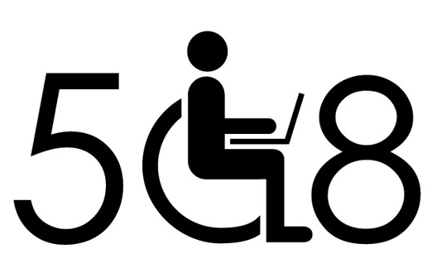
WCAG 2.0 Levels of Accessibility Standards
Level A | If content does not meet Level A, it will be IMPOSSIBLE for people with certain types of disabilities to access the content.
Level AA | If content does not meet Level AA, it will be VERY DIFFICULT for people with certain types of disabilities to access the content.
Level AAA | If content meets this level, it can make access much easier for people with disabilities.
Section 508 of the Rehabilitation Act now aligns with the Web Content Accessibility Guidelines, version 2.0, Level AA Accessibility Standards.
Notes:
There are three levels of conformance within WCAG:
Level A
Level Double-A and
Level Triple-A
If content doesn’t meet Level A requirements, it will be impossible for people with certain types of disabilities to access it.
If content doesn’t meet Level Double-A requirements, it will be very difficult for people with certain types of disabilities to access it.
For this reason, the federal government aligned with WCAG 2.0, Level Double-A as their standard for Section 508 of the Rehabilitation Act.

Slide 59
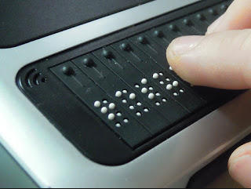
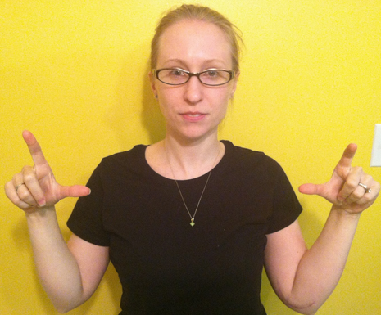
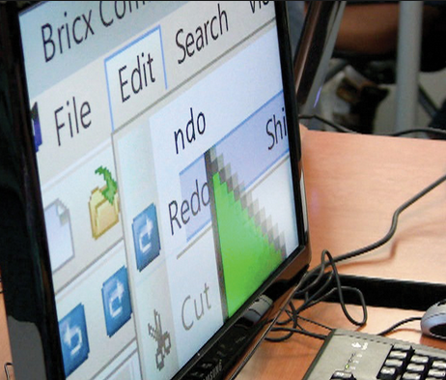
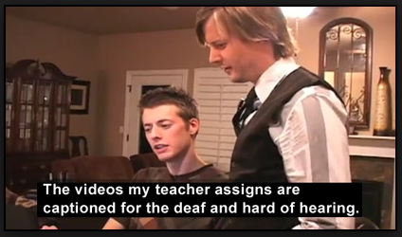
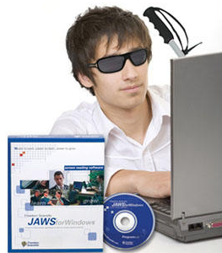
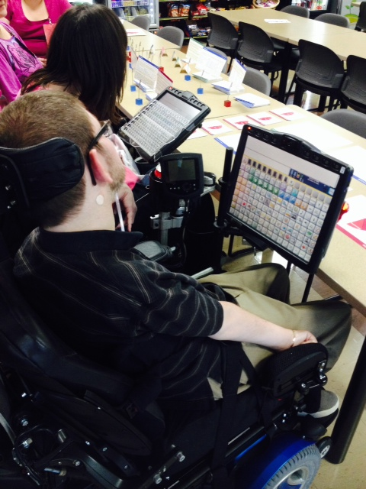
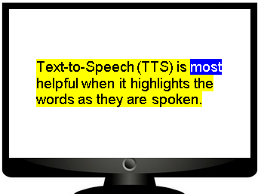
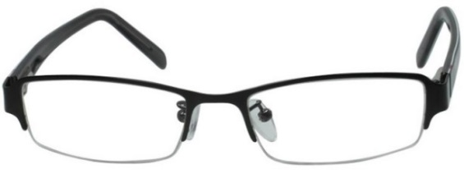
Specialized Tools
Some Examples Include: Refreshable Braille Displays, Screen Readers, Screen Magnifiers, Closed Captions, Sign Language Videos, Text-to-Speech with Synchronized Highlighting, Augmentative Communication Devices, and even something as simple as a pair of eye glasses
Notes:
When content is designed to comply with WCAG 2.0, Level AA, it is more likely to work with third-party assistive technology tools.
As mentioned earlier, there is a wide variety of assistive technology. Some examples include:
Refreshable Braille Displays
Screen Readers
Screen Magnifiers
Closed Captions
Sign Language Videos
Text-to-Speech with Synchronized Highlighting
Augmentative Communication Devices
And even something as common as … eye glasses.

Slide 60
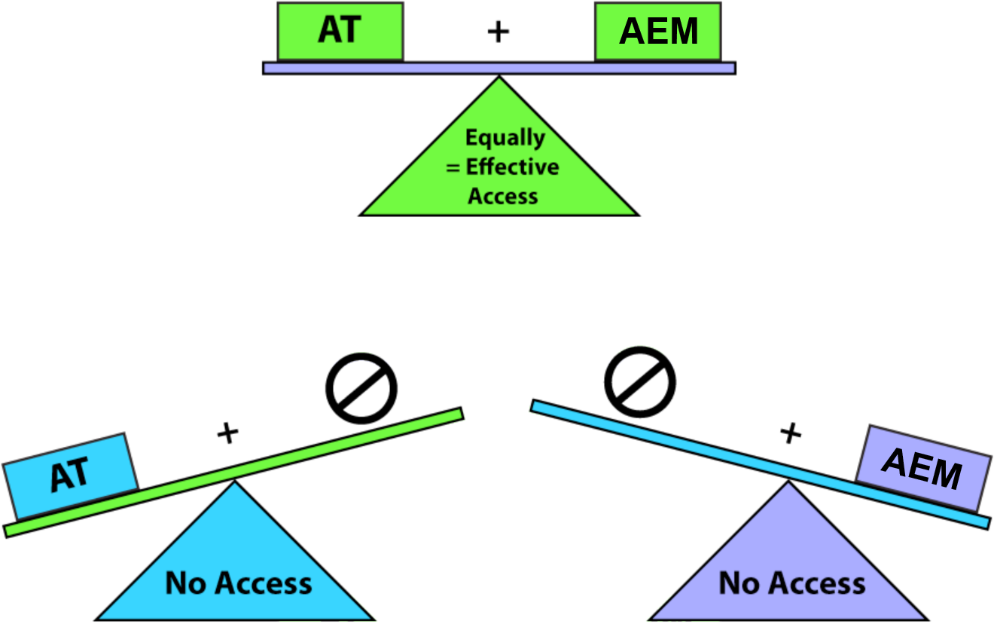
Two-Part Equation
Notes:
Think of access as a two-part equation: Assistive Technology + Accessible Educational Materials or AEM = Equally Effective Access to the general curriculum for students with disabilities.
If one part of the equation isn’t there, then access won’t be possible.

Slide 61
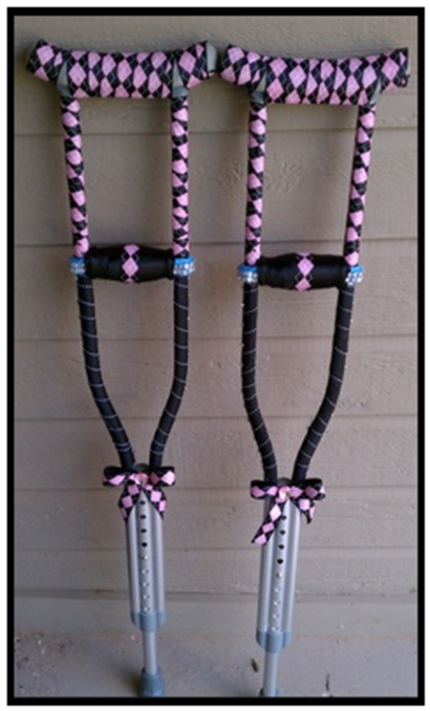
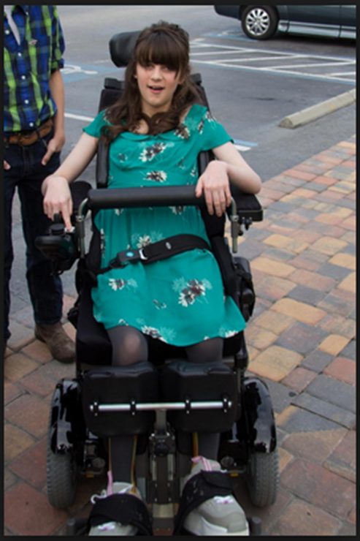
Two Types of Access
Integrated
Third-party
So let’s talk for a minute about how students with disabilities overcome barriers to digital content in the context of assessment.
On the screen you see a pair of crutches that for illustrative purposes are representing the APIP standard.
You also see a photograph of a girl in a customized wheelchair. This photo is meant to illustrate WCAG + ARIA standards and best practices, which testing companies can comply with in order to allow students to use third-party assistive technology
The crutches have been decorated with bows and decorative tape. It looks like they may have added some additional padding to the top of the crutches. You can also see that the crutches can be made taller or shorter, depending on the height of the user. In the same way that built-in accommodations through APIP are meant to help learners overcome minor barriers to accessing digital content, these crutches are designed to help people overcome the effects of a minor leg injury. Lots of people could use these crutches or similar crutches that perhaps are decorated in a different way. They could use the crutches with very little training and even though it might be slightly annoying to have to use crutches, you could at least still be mobile and accomplish a lot of tasks.
However, a person who needs a power wheelchair, will never be able to use a pair of crutches. They need a much more robust set of supports in order to accomplish what other people might accomplish with the crutches or without any support at all.
Notes:
Earlier, we talked about the evolution of assistive technology and how more and more of it is becoming an integrated part of the products we use in education, but there is still a need for third-party tools for complex access needs.
On the screen you see a pair of crutches that for illustrative purposes are representing the integrated access.
You also see a photograph of a girl in a customized wheelchair. This photo is meant to illustrate third-party assistive technology tools.
The crutches have been decorated with bows and decorative tape. It looks like they may have added some additional padding to the top of the crutches. You can also see that the crutches can be made taller or shorter, depending on the height of the user. In the same way that integrated access tools are meant to help learners overcome minor barriers to accessing digital content, these crutches are designed to help people overcome the effects of a minor leg injury. Lots of people could use these crutches or similar crutches that perhaps are decorated in a different way. They could use the crutches with very little training and even though it might be slightly annoying to have to use crutches, they could at least be mobile and accomplish a lot of tasks.
However, a person who needs a power wheelchair, will never be able to use a pair of crutches. They need a much more robust set of supports in order to accomplish what other people might accomplish with the crutches or without any support at all.

Slide 62

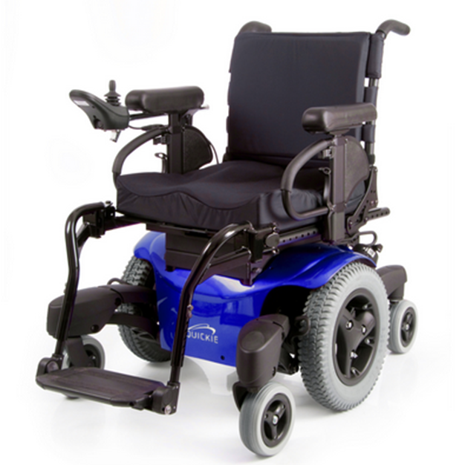
Efficacy of Access
And … the person who needs a power wheelchair, needs that chair to be customized to their unique needs. You will notice that the girl in this wheelchair, has a head rest, a bar across the middle of her chair to help her stabilize herself and she has a mechanism to hold her legs in place. In the same way, students who use complex assistive technologies will often customize how those tools work so that they can meet their unique needs. Students learn to use these complex tools to a level of muscle memory so that they don’t even have to think about how the tool works as they use it to complete their school work.
If we try to build in a complex access system, like a power wheelchair, no matter what we do it won’t be the same tool that students use every day with their customized settings. It won’t be a tool that students can use without having to think about how to use it. Notice that the other power wheelchair on this screen does not have the head set or the mechanism to hold the users legs in place, nor does it have a bar across the middle to help with stabilization.
This is meant to illustrate that if testing companies try to build in complicated access systems into an online assessment system, they may meet the needs of some students, but because they have taken away the students’ ability to choose their access system through third-party assistive technology, they have created a man-made barrier to success for students who’s access needs exceed or differ from what is built into the system.
Assistive Tec
Notes:
The reason that integrated access may not be sufficient for complex access needs is that you would have to assume that all users can generally use the “same” tool with very few modifications. However, you cannot make that assumption when you’re trying to accommodate complex needs. Personalization is absolutely essential for complex needs.
You cannot just assume that everyone who needs a wheelchair can use the same type of wheelchair design.
A person who needs a power wheelchair, needs that chair to be customized to their unique needs. You will notice that the girl in this wheelchair, has a head rest, a bar across the middle of her chair to help her stabilize herself and she has a mechanism to hold her legs in place.
In the same way, you cannot assume that everyone who needs a screen reader can use the same type of screen reader or everyone who needs a complex augmentative communication system can use the same type of system. Students who use complex assistive technologies will often customize how those tools work so that they can meet their unique needs. Students learn to use these complex tools to a level of muscle memory so that they don’t even have to think about how the tool works as they use it to complete their school work. For this reason, these types of access needs often require personalization that is too complex to build into digital tools.
If we try to build in a complex access system, like a power wheelchair, no matter what we do it won’t be the same tool that students use every day with their customized settings. It won’t be a tool that students can use without having to think about how to use it, which means that cognitive energy will be spent on using an access tool, rather than on learning.
Notice that the other power wheelchair on this screen does not have the head set or the mechanism to hold the user’s legs in place, nor does it have a bar across the middle to help with stabilization.
This is meant to illustrate that if complicated access systems are built into digital products, they may meet the needs of some students, but because they have taken away the students’ ability to choose their access system through third-party assistive technology, they have created a man-made barrier to success for students who’s access needs exceed or differ from what is built into the system.
Think about how many digital education tools are in the market today. What will happen to students with disabilities if they have to learn a new access system for each digital product?
There is simply a limit to what we can do with integrated access.

Slide 63
Accessibility provides for personalization and flexibility in learning.
Notes:
In summary, accessibility is about providing choices and improving the efficiency of students when they access digital content. Accessibility provides for personalization and flexibility in learning.

Slide 64
Handshake vs. Hammer
Notes:
Often times, school districts are not aware of their legal obligations to provide equally effective access to the curriculum and sometimes when they are aware, they choose to ignore their obligations and risk litigation. Depending on the circumstances, there is precedent for using the law as a handshake or as a hammer. The next few slides will describe the difference.

Slide 65

Legal Landscape
Separate and apart from IDEA obligations, Title II of the ADA requires school districts to provide:
Appropriate auxiliary aids and services
In meeting this obligation, school districts shall give primary consideration to the auxiliary aid or service requested by the student with the disability when determining what is appropriate for that student. 28 CFR § 35.160(b)(2).
The public school district has similar obligations under Section 504 of the Rehabilitation Act. See 34 CFR pt. 104, Subparts A and D; specifically, 34 CFR § 105.40 (effective communication).
The legal obligation requires that aurally or visually delivered information must be available to students so that they can receive information from, and convey information to, others as effectively as students without disabilities
Separate and apart from IDEA obligations, Title II of the ADA requires school districts to provide:
Appropriate auxiliary aids and services, such that communication with students with disabilities is as effective as communication with students without disabilities. That is, schools must provide appropriate auxiliary aids and services so that students with disabilities have an equal opportunity to participate in, and enjoy the benefits of, the services, programs, and activities of the public school district. 28 CFR § 35.160(b)(1).
In meeting this obligation, school districts shall give primary consideration to the auxiliary aid or service requested by the student with the disability when determining what is appropriate for that student. 28 CFR § 35.160(b)(2).
If a public school district can prove that complying with this obligation would be a fundamental alteration in the nature of the service, program or activity, or an undue financial and administrative burden, the public school district does not need to provide the auxiliary aid or service, however, it must, to the maximum extent possible, provide an effective auxiliary aid or service. 28 CFR § 35.164.
The public school district has similar obligations under Section 504 of the Rehabilitation Act. See 34 CFR pt. 104, Subparts A and D; specifically, 34 CFR § 105.40 (effective communication).
The legal obligation requires that aurally or visually delivered information must be available to students with hearing, vision or speech disabilities so that they can receive information from, and convey information to, others as effectively as students without disabilities. See Frequently Asked Questions on Effective Communication for Students with Hearing, Vision, or Speech Disabilities in Public Elementary and Secondary Schools: https://www2.ed.gov/about/offices/list/ocr/docs/dcl-faqs-effective-communication-201411.pdf
Notes:
Separate and apart from IDEA obligations, Title II of the ADA requires school districts to provide:
Appropriate auxiliary aids and services, such that communication with students with disabilities is as effective as communication with students without disabilities. That is, schools must provide appropriate auxiliary aids and services so that students with disabilities have an equal opportunity to participate in, and enjoy the benefits of, the services, programs, and activities of the public school district. 28 CFR § 35.160(b)(1).
In meeting this obligation, school districts shall give primary consideration to the auxiliary aid or service requested by the student with the disability when determining what is appropriate for that student. 28 CFR § 35.160(b)(2).
If a public school district can prove that complying with this obligation would be a fundamental alteration in the nature of the service, program or activity, or an undue financial and administrative burden, the public school district does not need to provide the auxiliary aid or service, however, it must, to the maximum extent possible, provide an effective auxiliary aid or service. 28 CFR § 35.164.
The public school district has similar obligations under Section 504 of the Rehabilitation Act. See 34 CFR pt. 104, Subparts A and D; specifically, 34 CFR § 105.40 (effective communication).
The legal obligation requires that aurally or visually delivered information must be available to students with hearing, vision or speech disabilities so that they can receive information from, and convey information to, others as effectively as students without disabilities. See Frequently Asked Questions on Effective Communication for Students with Hearing, Vision, or Speech Disabilities in Public Elementary and Secondary Schools: https://www2.ed.gov/about/offices/list/ocr/docs/dcl-faqs-effective-communication-201411.pdf

Slide 66
Different Forms of Legal Action
Discussion and Negotiation
Litigation or Federal Enforcement
Let’s take a look at recent examples of these types of actions.

Slide 67

Example #1: Negotiation, Non-Litigation
Large Virginia School District:
Changes in Procurement (short term and long term)
Internal Audit of EIT: Software Applications
Significant Training for Administrators and Teachers

Slide 68

Example #2: Litigation Led to Consent Decree
Seattle Public School District:
Ensure that students with disabilities acquire the same information, engage in the same instructions, and enjoy the same services as nondisabled students with substantially equivalent ease of use.
Agreement sets forth specific standards for ensuring accessibility (WCAG 2.0)
Designation of Accessibility Coordinator
Creation of an Accessible Educational Resources Portal
Significant Accessibility Training
Procurement Obligations
Internal Audit, Evaluation and Corrective Action Plan
Compensatory Damages and Attorneys’ Fees
Seattle Public School District: litigation led to Consent Decree (http://www.seattleschools.org/UserFiles/Servers/Server_543/File/District/Departments/School%20Board/15-16agendas/081915agenda/20150819_ADAWebsite_Decree.pdf)
System changes to ensure that websites comply with accessibility standards of WCAG 2.0 AA and that students with disabilities acquire the same information, engage in the same instructions, and enjoy the same services as nondisabled students with substantially equivalent ease of use.
Agreement sets forth specific standards for ensuring accessibility
Designation of Accessibility Coordinator
Creation of an Accessible Educational Resources Portal
Significant Accessibility Training
Procurement Obligations
Internal Audit, Evaluation and Corrective Action Plan
Compensatory Damages and Attorneys’ Fees
Notes:
Seattle Public School District: litigation led to Consent Decree (http://www.seattleschools.org/UserFiles/Servers/Server_543/File/District/Departments/School%20Board/15-16agendas/081915agenda/20150819_ADAWebsite_Decree.pdf)
System changes to ensure that websites comply with accessibility standards of WCAG 2.0 AA and that students with disabilities acquire the same information, engage in the same instructions, and enjoy the same services as nondisabled students with substantially equivalent ease of use.
Agreement sets forth specific standards for ensuring accessibility
Designation of Accessibility Coordinator
Creation of an Accessible Educational Resources Portal
Significant Accessibility Training
Procurement Obligations
Internal Audit, Evaluation and Corrective Action Plan
Compensatory Damages and Attorneys’ Fees

Slide 69

But, Wait! There’s More!
There are Multiple OCR examples of Resolution Agreements Reached in 2015 – 2016 that require the following provisions:
Assurances of Nondiscrimination
Benchmarks for Measuring Accessibility
Development of New Policies and Procedures for Online Content and Functionality to Ensure Accessibility
Assessment of Accessibility and Functionality of Existing Content
Corrective Action Plan
Training
Reporting Requirements
On-going OCR Monitoring

Slide 70
OCR Resolution Agreements
Washington Office of Superintendent of Public Schools: https://www2.ed.gov/about/offices/list/ocr/docs/investigations/more/10161103-a.pdf and https://www2.ed.gov/about/offices/list/ocr/docs/investigations/more/10161103-b.pdf.
Washoe County School District: https://www2.ed.gov/about/offices/list/ocr/docs/investigations/more/10161134-a.pdf and https://www2.ed.gov/about/offices/list/ocr/docs/investigations/more/10161134-b.pdf.
Santa Fe Public Schools, New Mexico: https://www2.ed.gov/about/offices/list/ocr/docs/investigations/more/08161189-a.pdf and https://www2.ed.gov/about/offices/list/ocr/docs/investigations/more/08161189-b.pdf.

Slide 71
More OCR Resolution Agreements
Oregon Department of Education, OCR Reference No. 10161102: https://www2.ed.gov/about/offices/list/ocr/docs/investigations/more/10161102-a.pdf and https://www2.ed.gov/about/offices/list/ocr/docs/investigations/more/10161102-b.pdf.
Nevada Department of Education, OCR Reference No. 10161101: https://www2.ed.gov/about/offices/list/ocr/docs/investigations/more/10161101-a.pdf and https://www2.ed.gov/about/offices/list/ocr/docs/investigations/more/10161101-b.pdf.

Slide 72
And more …
Montana School for the Deaf and Blind, OCR Reference No. 10161160: https://www2.ed.gov/about/offices/list/ocr/docs/investigations/more/10161160-a.pdf and https://www2.ed.gov/about/offices/list/ocr/docs/investigations/more/10161160-b.pdf.
Granite School District, Utah, Case No. 08-16-1232: https://www2.ed.gov/about/offices/list/ocr/docs/investigations/more/08161232-a.pdf and https://www2.ed.gov/about/offices/list/ocr/docs/investigations/more/08161232-b.pdf.

Slide 73
And more …
Davidson Academy of Nevada, OCR Reference No. 10161133: https://www2.ed.gov/about/offices/list/ocr/docs/investigations/more/10161133-a.pdf and https://www2.ed.gov/about/offices/list/ocr/docs/investigations/more/10161133-b.pdf.
Bellingham School District No. 501, OCR Reference 10161108: https://www2.ed.gov/about/offices/list/ocr/docs/investigations/more/10161108-a.pdf and https://www2.ed.gov/about/offices/list/ocr/docs/investigations/more/10161108-b.pdf.

Slide 74
And more …
Juneau School District, OCR Reference No. 10161109: https://www2.ed.gov/about/offices/list/ocr/docs/investigations/more/10161109-a.pdf and https://www2.ed.gov/about/offices/list/ocr/docs/investigations/more/10161109-b.pdf.
Michigan Health, Education & Family Services Division, Resolution Agreement, OCR Docket No. 15-14-1110: https://www2.ed.gov/about/offices/list/ocr/docs/investigations/more/15141110-a.pdf and https://www2.ed.gov/about/offices/list/ocr/docs/investigations/more/15141110-b.pdf.

Slide 75
A Very Different Federal Administration …
On June 27, 2017, the Office of Civil Rights (OCR) for the Department of Education issued a number of resolution agreements to K12 school districts regarding the accessibility of their web sites. The Galveston Independent School District was one of these districts: OCR Reference Number 06-17-1088 (https://www2.ed.gov/about/offices/list/ocr/docs/investigations/more/06171088-b.pdf)
In April 2018, the OCR issued several modified resolution agreements – changing the agreements previously reached with at least 10 school districts regarding their obligations concerning web accessibility. Please see the modified Galveston agreement at: http://accessibility.pearson.com/assessment/conferences/accessu2018.html
Notes:
Instead of providing a clear roadmap for the District, including the requirement for an audit, specifying the standards that accessibility will be measured by, requiring policy changes and training, the modified agreements are much more bare boned.

Slide 76
Group Activity #2
Revisit Definitions:
Any changes to your definition of accessibility?
Any changes to the roles in a school district that need to be involved in supporting accessibility?

Slide 77
Break #2 … 2:30 – 2:50
Time for a break
Notes:
Time for a break. Please be back here and ready to start by 2:50.

Slide 78
Section 3 2:50 – 4:15
Notes:
Power of Procurement
Group Activity #2 (Talking to Vendors)

Slide 79

You Have the Power … of Procurement!
Young girl in home-made super girl costume, arms crossed, goggles on, looking determined!

Slide 80
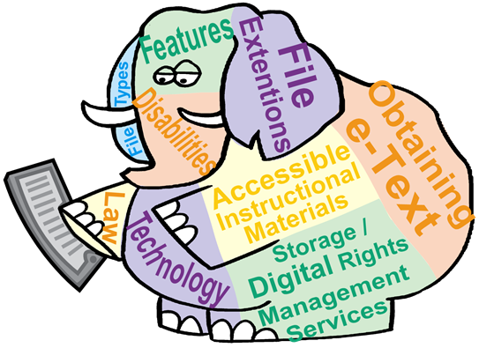
Seems obvious, but …
2014 U.S. Education Technology Industry Market PreK-12 Report
Schools spend $8.4 billion dollars a year on educational software and digital content.
Why is the vast majority of this money spent on content that categorically denies access to students who are historically the most difficult to serve?
A patchwork elephant is holding a mobile device. He has words printed all over him that say, “Features, File types, file extensions, Obtaining e-text, accessible instructional materials, technology, storage, digital rights management services, and law.
Notes:
According to the 2014 U.S. Education Technology Industry Market: PreK-12 Report Educational Software and Digital content is a $8.4 billion industry.

Slide 81
Myth vs. Fact
Myth
Fact
Making things accessible will slow down progress.
Making things accessible means that you are dumbing everything down for everyone.
Making things accessible speeds up progress because you’re not wasting time and money on adaptations.
Making things accessible makes them more flexible to meet a broader range of needs, including the needs of gifted students.
Notes:
One reason may be that school personnel often believe in two myths.

Slide 82

Inaccessible content doesn’t add up …
A circular pie with a paper dollar sign laying on top. Four pairs of hands are reaching in, trying to get pieces of the pie.
Duplication of efforts
Dilution of quality across the board
Increased cost in personnel & materials
Inequitable content

Slide 83
You Can’t Buy Love, but You Can Buy Accessibility!

Slide 84

Sample Procurement Language
The solution must comply with the Information Technology Accessibility Act (citation from State Code) which requires that information technology developed, purchased, or provided is accessible to individuals with disabilities. All products and services must comply with and conform to the guidelines for website accessibility set forth by the World Wide Web Consortium’s Version 2.0 of the Web Content Accessibility Guidelines (“WCAG 2.0”) Level AA success criteria. Offeror must provide information on how their solution complies with these guidelines, and provide information about the product’s compatibility with Freedom Scientific’s JAWS screen-reader application.

Slide 85
What is a VPAT®?
Voluntary Product Accessibility Template:
https://www.itic.org/policy/accessibility/vpat
ITI has updated the VPAT® report form to incorporate the revised and updated Section 508 ICT accessibility standards, published by the U.S. Access Board in the Federal Register on January 22, 2017.
The updated VPAT 2.1 includes the following features:
A universal format that can be used to produce an Accessibility Conformance Report documenting conformance with three prominent accessibility standards:
Revised Section 508 standards – the U.S. Federal accessibility standard
EN 301 549 – the European Union’s “Accessibility requirements suitable for public procurement of ICT products and services in Europe”
WCAG 2.0 or ISO/IEC 40500 – W3C/WAI’s Web Content Accessibility Guidelines
Notes:
VPATs are the industry standard for responding to US 508 accessibility inquiries

Slide 86

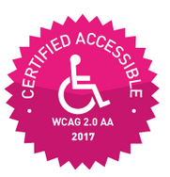
Fox Watching the Hen House
Because VPATs are filled out by the vendor about their own product, it can be a little bit like having a fox watching a hen house.
If someone makes a claim that their product is WCAG 2.0 AA certified, they are not being truthful. There is no such certification.

Slide 87

Sample 3rd-Party Validation
Cal State:
Proposers selected to Phase II will be required to provide, at their expense, a comprehensive third party product accessibility evaluation that verifies the claims made on the product VPAT(s) based on the product use cases, which will be provided at a later date by the CSU Evaluation Committee.
Cal State RFP posted at:
http://accessibility.pearson.com/assessment/conferences/accessu2018.html

Slide 88
Talking to Vendors

Slide 89

Introducing Quizlet! A Vendor Presentation https://quizlet.com/ Quizlet for Students with Low Vision

Slide 90
Large Group Activity
Discuss:
What did you learn about the accessibility of the product?
What can you do to determine if the accessibility claims are accurate?

Slide 91

What do the AT experts say?
Quizlet in Windows
Quizlet on Mobile

Slide 92
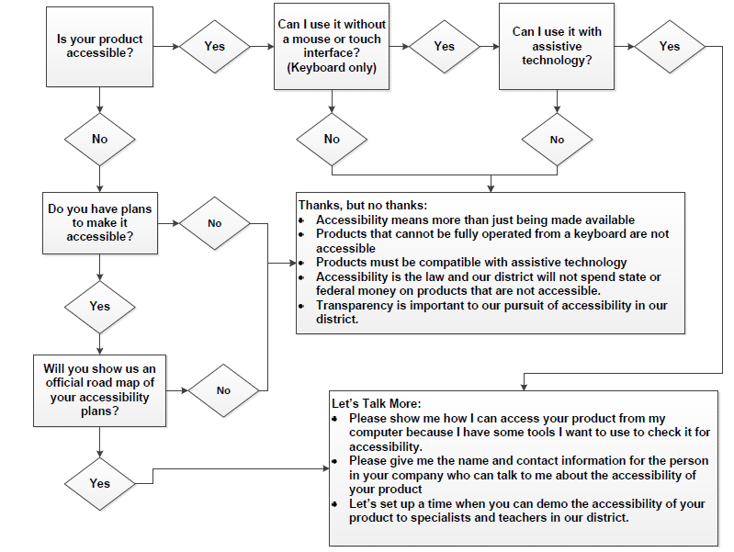

Know What Questions to Ask
Scenario One:
Is your product accessible?
If yes, ask “Can I use it without a mouse or a touch interface (Keyboard Only)?”
If yes, ask “Can I use it with assistive technology?
If yes, tell the vendor you’re interested in learning more and ask the vendor to:
Show you how to access the product from your computer so that you can check it for accessibility
Give you the name and contact information for the person in their company who can talk to you about the accessibility of their product
Set up a time when the vendor can demo the accessibility of their product to specialists and teachers in your district.
Scenario Two:
Is your product accessible?
If yes, ask “Can I use it without a mouse or a touch interface (Keyboard Only)?”
If no, say, “Accessibility means more than just being made available and products that cannot be fully operated from a keyboard are not accessible.”
Scenario Three:
Is your product accessible?
If yes, ask “Can I use it without a mouse or a touch interface (Keyboard Only)?”
If yes, ask “Can I use it with assistive technology?
If no, say, “Products must be compatible with assistive technology.”
Scenario Four:
Is your product accessible?
If no, say, “Do you have plans to make it accessible?”
If no, say, “Accessibility is the law and our district will not spend state or federal money on products that are not accessible.”
If yes, say, “Will you show us an official road map of your accessibility plans?”
If no, say, “Transparency is important to our pursuit of accessibility in our district and if you’re not willing to show us your plans to become accessible, then we are probably not going to work well together.”
If yes, tell the vendor you’re interested in learning more and ask the vendor to:
Show you how to access the product from your computer so that you can check it for accessibility
Give you the name and contact information for the person in their company who can talk to you about the accessibility of their product
Set up a time when the vendor can demo the accessibility of their product to specialists and teachers in your district.
Notes:
But you don’t have to be an AT Expert to talk to vendors. There is a way to do some simple checking without getting technical.

Slide 93

Free Guidance & Tools!
Start with WAI
Newly redesigned WAI website
What is accessibility?
Talking points from W3C
What is your role?
Admin/Planning
Advocate
Technical: Quick Tips, Deep Dive Tutorials
Buyer – Texas HHC has explicit policy and contract language
Remember, technology is a tool. You are the expert to identify how technology can be put to use to solve educational challenges for all students....

Slide 94
Learn More at AccessU 2018
Starter classes:
Beginner’s Basics
Easy Checks
Testing Tools for Everyone
Video Captioning Fun with Gene and Dave
Audio Description in Video
EDU classes:
Developing Accessibility Knowledge in K12
Just in Time Learning – for everyone
Accessible Math
All Kids Can Learn
Inclusive Classrooms

Slide 95
Changing the Culture … One District’s Journey

Slide 96
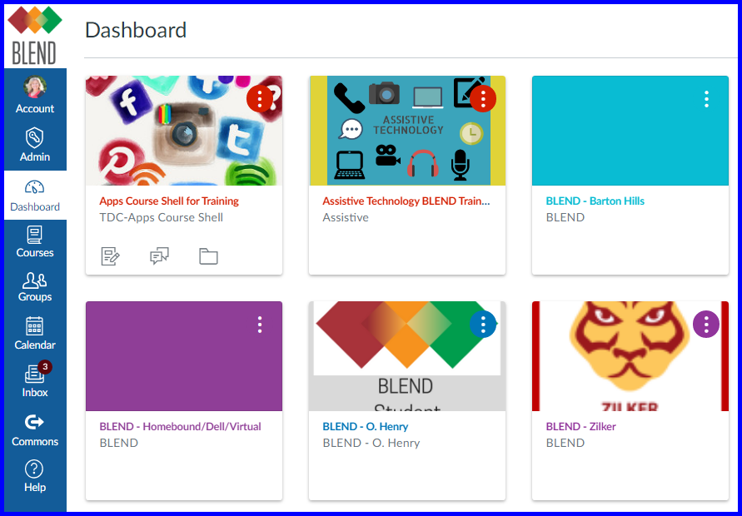
Implementing a District-Wide LMS
In the fall of 2017, Austin ISD piloted and licensed “BLEND” (Canvas), an LMS that we now use district wide for digital content. Our professional development soon began to include how to design digital content in BLEND. Moving forward, we begin including small chunks of learning in our BLEND Monthly Focus to teachers by layering in learning components of Accessible design.

Slide 97

Assistive Technology Deployment: Large Urban District
Barriers:
Compartmentalization
Special Ed
Funding stream for students with disabilities
Support Services for students with disabilities
Gen Ed
Curriculum Decisions that impact entire district
Technology
Platform decisions that impact entire district
Don’t know what they don’t know

Slide 98


Arrrr … Thar be a sea o’ Chocolate, Matey!
Notes:
Show people that you are grateful for them.
They may tell you that they are just doing their job, but let them know that because they do their job well, you are better able to do your job.
Be silly – this gives them something to smile about and to remember. When you don’t take yourself too seriously, it puts people at ease and helps to build trust.
M&Ms have magical powers. ;-)

Slide 99
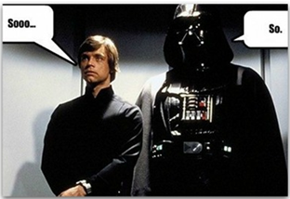
Accessibility Elevator Speech
Luke Skywalker and Darth Vader standing next to each other in an elevator, looking straight ahead. Both are saying “So….”
Civil rights require that students with disabilities have “equally effective access to the general curriculum.”
Equal access to content can positively impact student outcomes.
Accessible content is more flexible and more cost-effective, and supports personalized learning.

Slide 100
Group Activity #3
Revisit Definitions:
Any changes to your definition of accessibility?
Any changes to the roles in a school district that need to be involved in supporting accessibility?
Outline:
How to get leadership buy-in; make an elevator speech.
How to build effective accessibility supports (e.g. separate accessibility policy or woven into other policies)
What kinds of training are needed?

Slide 101

In Summary
For the best results, bake accessibility in from the top down.
Understand the impact on students
Understand the District’s digital technology barriers through an audit
Do not be afraid of the results; own them and be willing to fix them
Develop a District Accessibility Policy
Stop the bleeding first and then go back and deal with legacy products
Make demands on vendors and hold them accountable
Notes:
It is all about changing culture and baking in accessibility from the top down:
Understand the impact on students of not providing accessibility
Understand the District’s digital technology barriers through an audit
Do not be afraid of these results; own them and be willing to fix them
Develop a District Accessibility Policy
Stop the bleeding first and then go back and find equally effective alternatives for legacy products
Make demands on vendors and hold them accountable
We should want to change the role of our AT specialists: they are our experts but let’s use their expertise differently
Training, Training, Training

Slide 102
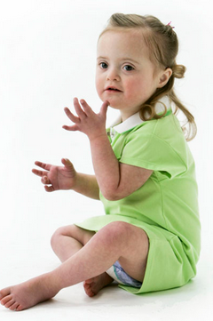
Thank You!!
Slides Available at: http://accessibility.pearson.com/assessment/conferences/accessu2018.html

Slide 103
References – Slide 1
Disabled World. “Disability Facts and Statistics.” Published May 30, 2017. Revised June 9, 2017. Available online June 16, 2017: https://www.disabled-world.com/disability/statistics/scc.php#age.
The National Center on Disability and Access to Education.
“Importance of the GOALS Cost Case Studies.” Available online June 17, 2017: http://ncdae.org/resources/articles/casestudies.php.

Slide 104
References – Slide 2
U.S. Department of Education, Office of Special Education Programs, Individuals with Disabilities Education Act (IDEA) database. Available online, July 26, 2016: https://www2.ed.gov/programs/osepidea/618-data/state-level-data-files/index.html#bcc. See Digest of Education Statistics 2016, table 204.30
Brookings Institute. Up Front. Matthew Chingos. February 2, 2015. “Testing Costs a Drop in the Bucket.” Available online June 17, 2017: https://www.brookings.edu/blog/up-front/2015/02/02/testing-costs-a-drop-in-the-bucket/.

Slide 105
References – Slide 3
World Health Organization. Health Topics. “Disabilities.” Available online June 17, 2017: http://www.who.int/topics/disabilities/en/.
World Health Organization. Infographic. “Better Health for People with Disabilities.” Available online June 17, 2017: http://www.who.int/disabilities/facts/Infographic_en_pdf.pdf?ua=1.
Disabled World. Cognitive Disability: Information on Intellectual Disability. “Definition: Cognitive Disability.” Available online June 17, 2017: https://www.disabled-world.com/disability/types/cognitive/.

Slide 106
References – Slide 4
Goodreads. “Dieter Rams Quote.” Available online June 17, 2017: http://www.goodreads.com/quotes/4505184-indifference-towards-people-and-the-reality-in-which-they-live.
Rose, T. (2016) The End of Average. New York: HarperOne
Deque Systems. “Style Guide.” Available online June 17, 2017: https://pattern-library.dequelabs.com/overview/design-principles.

Slide 107
References – Slide 5
Karl Groves. Tech Accessibility Consultant. “Reduction of Legal Risk as Web Accessibility Business Case.” Available online July 2, 2017: http://www.karlgroves.com/2011/12/08/reduction-of-legal-risk-as-accessibility-business-case/.
Colour Contrast Analyser. Available online May 13, 2018: https://developer.paciellogroup.com/resources/contrastanalyser/
Quizlet. Available online May 13, 2018: https://quizlet.com/

Slide 108
References – Slide 6
WebAIM. WAVE Toolbar. Available online May 13, 2018: http://wave.webaim.org/
Accessibility Bookmarklets. Highlight Accessibility Features of Web Pages. Available online May 13, 2018: http://accessibility-bookmarklets.org/install.html
WebAIM. Web Accessibility In Mind – Resources Page. Available online May 13, 2018: http://webaim.org/resources/

Slide 109
References – Slide 7
Center for Parent Information and Resources. Categories of Disabilities Under IDEA. Available online May 13, 2018: http://www.parentcenterhub.org/categories/.
U.S. Department of Education. Thirty-eighth Annual Report to Congress on the Implementation of the Individuals with Disabilities Education Act, 2016. Available online on May 13, 2018: https://www2.ed.gov/about/reports/annual/osep/2016/parts-b-c/38th-arc-for-idea.pdf

Slide 110
References – Slide 8
U.S. Department of Education. Static Tables. Available online May 13, 2018: https://www2.ed.gov/programs/osepidea/618-data/static-tables/index.html.
National Center for Education Statistics (NCES). Children and Youth with Disabilities. Available online May 13, 2018: https://nces.ed.gov/programs/coe/indicator_cgg.asp.

Slide 111
ALWAYS LEARNING

