Slide 1


Walk Through WAI Resources
Brent Bakken
Director, Accessibility Strategy & Education Services
Pearson Assessment
brent.bakken@pearson.com

Slide 2
Accessibility
There are many ways to approach accessibility.

Slide 3

“Band-Aid” approach

Slide 4
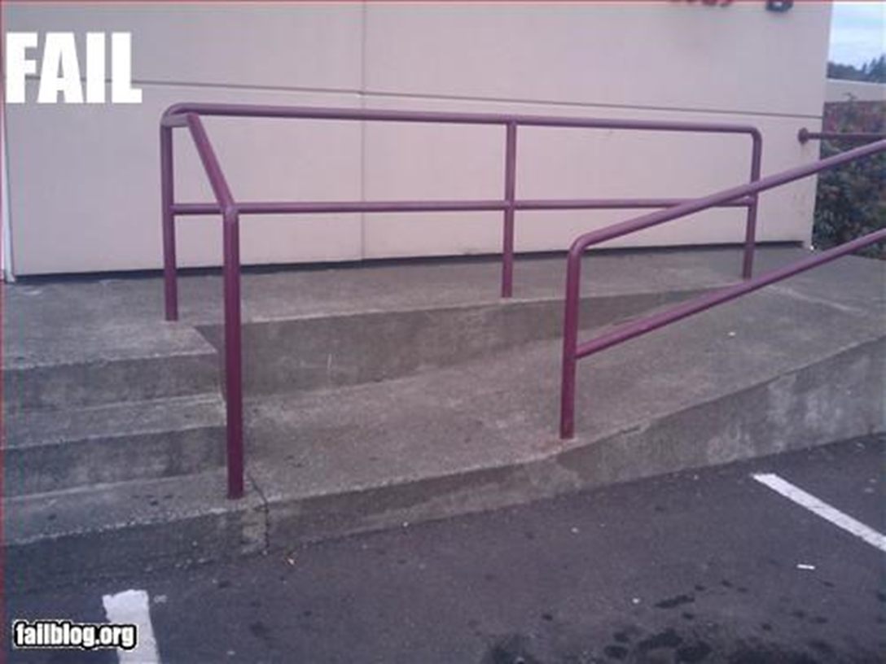
“Great design, but not functional” approach

Slide 5

“Hey, we added it, you go ahead and try it” approach

Slide 6
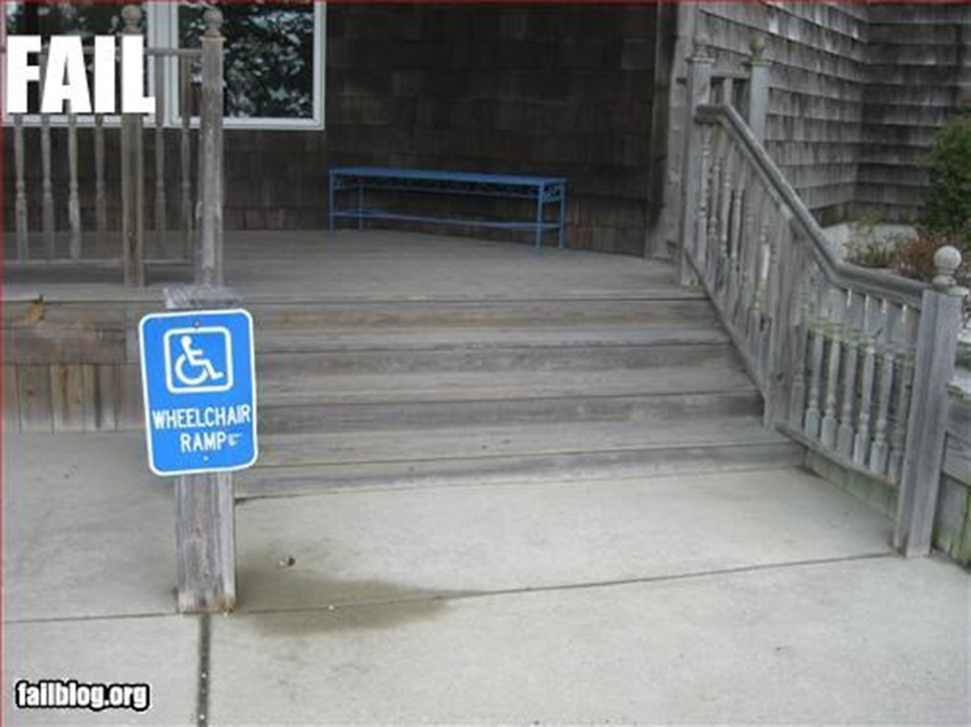
“We say it is, but it’s really not” approach

Slide 7

“Solution that works but ends up being worse” approach

Slide 8
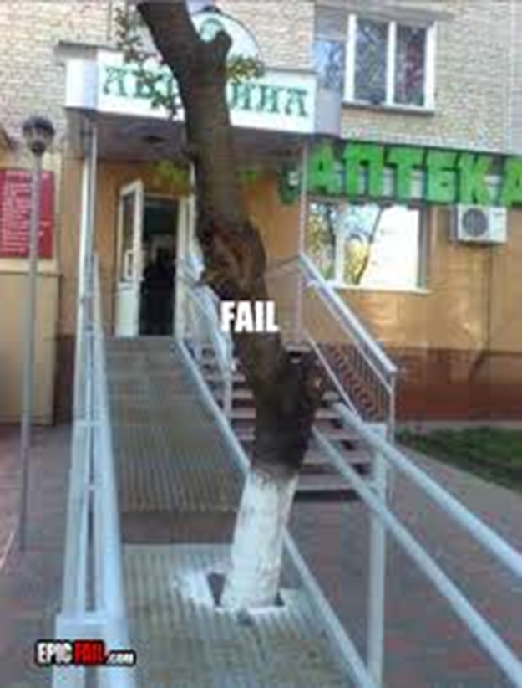
“There are still some bugs to be worked out” approach

Slide 9
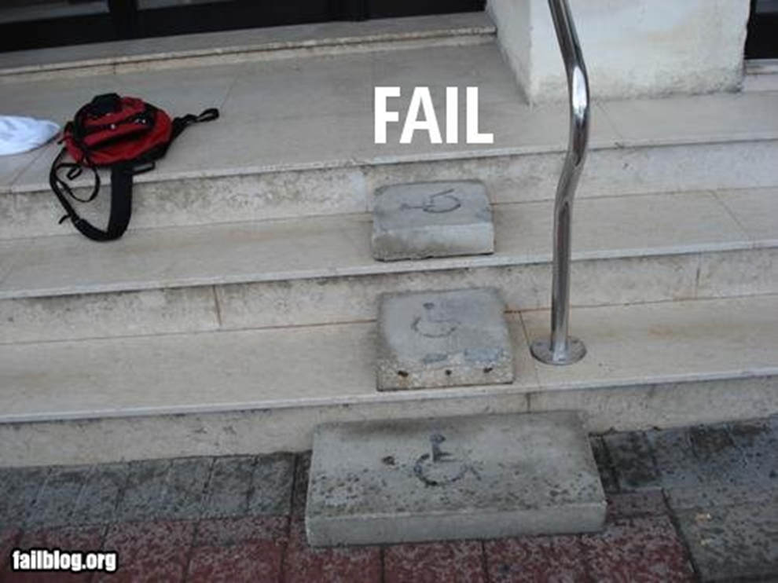
“We don’t really understand the users’ needs” approach

Slide 10
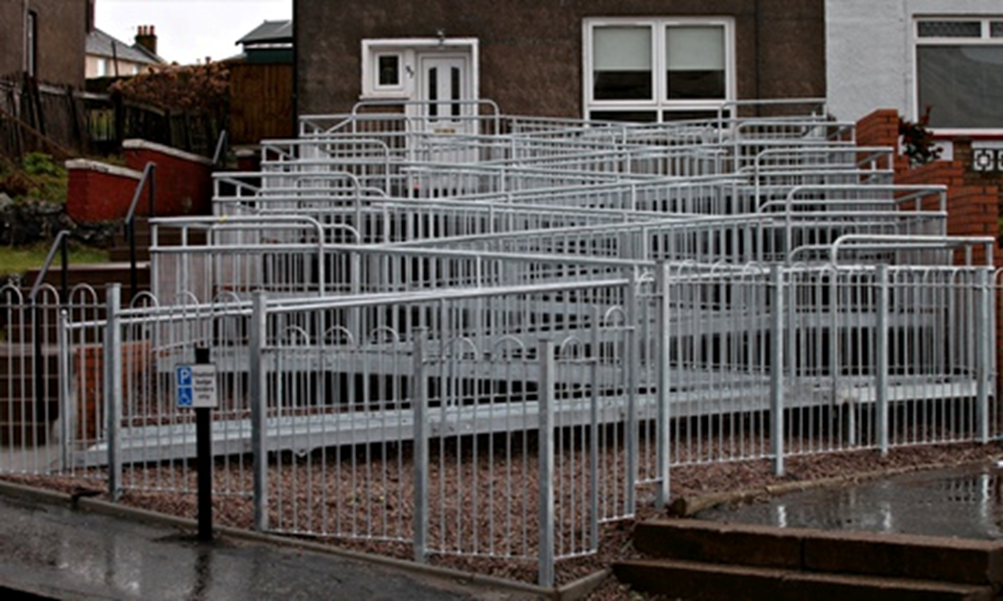
“Over thought and complicated” approach

Slide 11
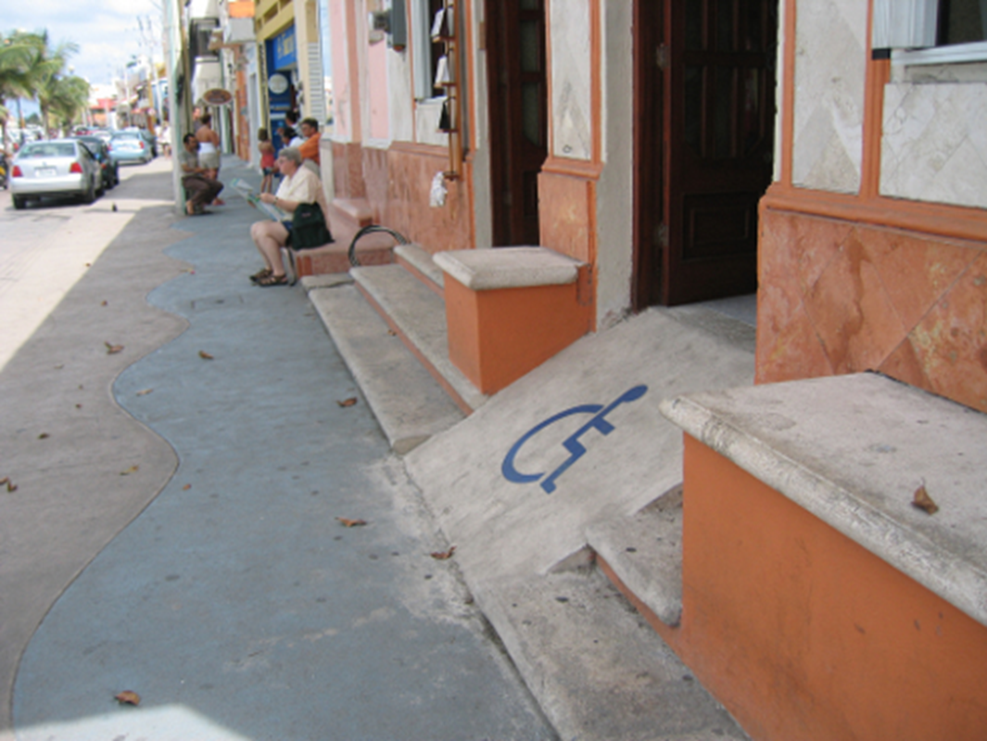
“We’re just meeting conformance” approach

Slide 12
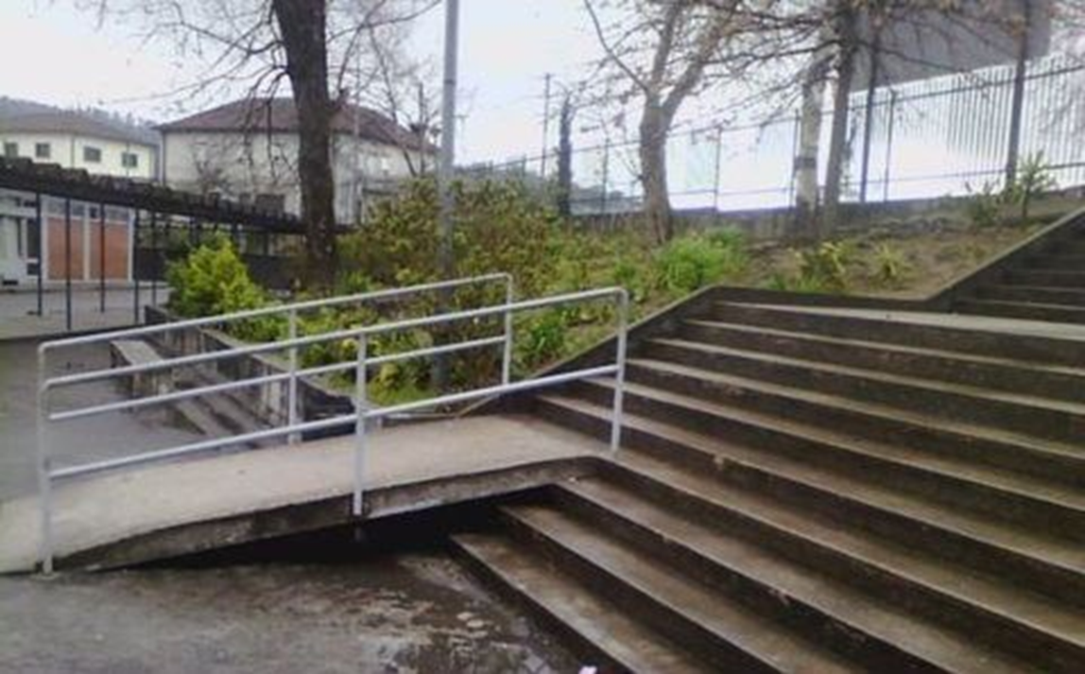
“We didn’t plan it all the way through” approach

Slide 13
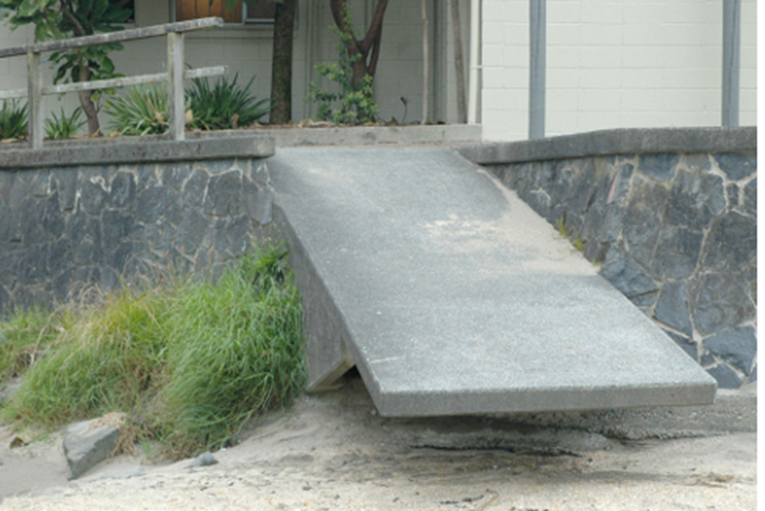
“We had it working but forgot to maintain it” approach

Slide 14
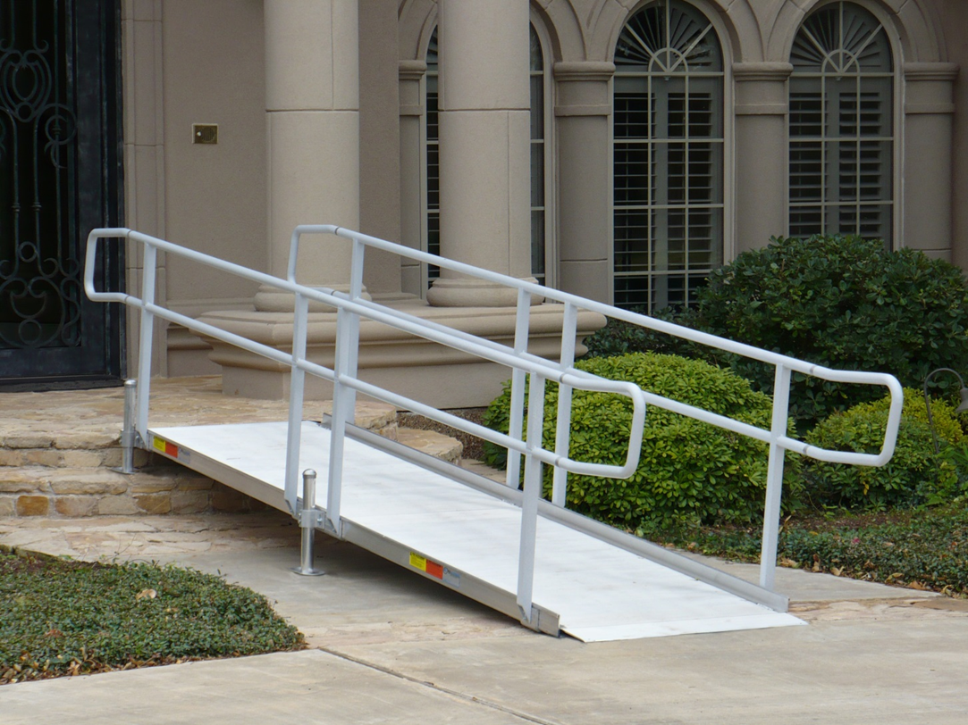
“We did it right, but we still did it after the fact” approach

Slide 15


The Well planned practical approach

Slide 16
Accessibility
There are many ways to approach accessibility.
The best approach will include a lot of thought,
from the start, done right, and maintained.

Slide 17
Show Me the WAI
Web Accessibility Initiative (WAI)
Provide Pointers
Promote Understanding
Provide Direction and Guidance
Provide Resources and Tools
Invitation to Join and/or Contribute

Slide 18
Who is the W3C?
The World Wide Web Consortium (W3C) is an international community where Member organizations, a full-time staff, and the public work together to develop Web standards.
W3C develops these technical specifications and guidelines through a process designed to maximize consensus about the content of a technical report, to ensure high technical and editorial quality, and to earn endorsement by W3C and the broader community.
Link to the W3C Standards: <https://www.w3.org/standards/>

Slide 19
What is WCAG?
Web Content Accessibility Guidelines (WCAG) is developed through the W3C process in cooperation with individuals and organizations around the world, with a goal of providing a single shared standard for web content accessibility that meets the needs of individuals, organizations, and governments internationally.
The WCAG documents explain how to make web content more accessible to people with disabilities. Web "content" generally refers to the information in a web page or web application, including:
natural information such as text, images, and sounds
code or markup that defines structure, presentation, etc.

Slide 20
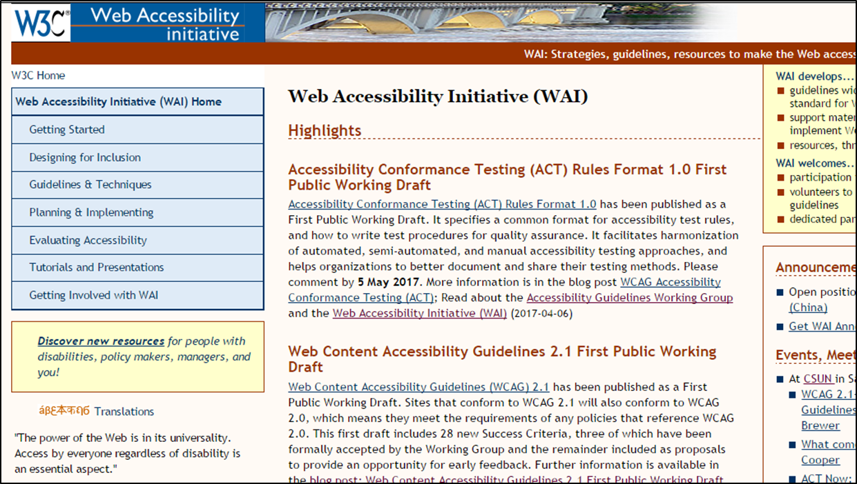
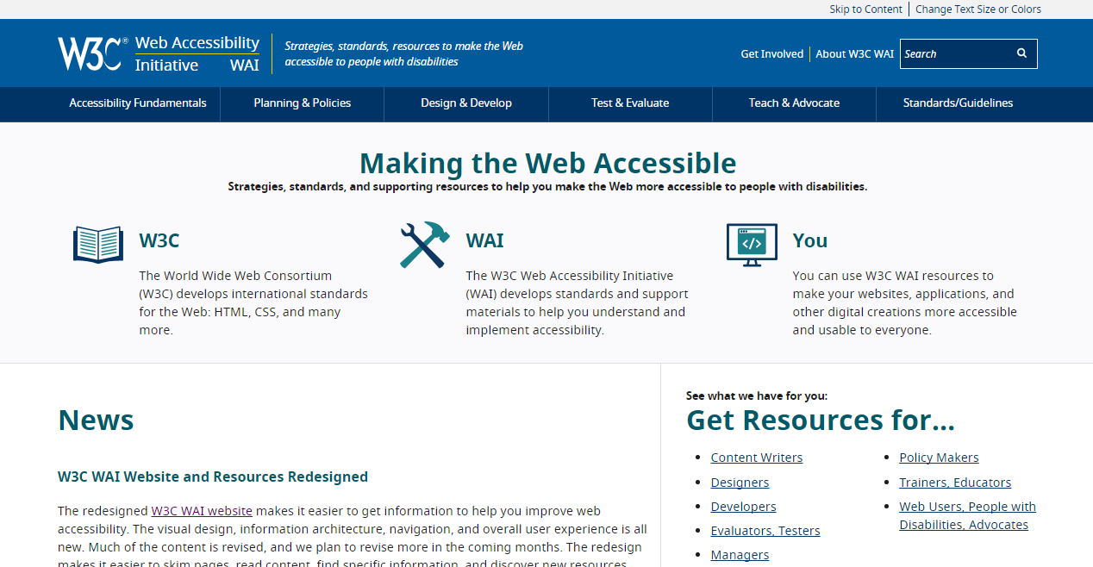
WAI Website Redesign

Slide 21
WAI Website Redesign
The WAI web site has recently undergone a redesign led by the Education & Outreach Working Group. Redesign efforts focused on four major changes to the WAI site:
Visual Design → (modern looking site that is visually appealing)
Information Architecture → (intuitive navigation and organization)
Updating and improving resource → (more relevant and concise)
Retiring older resources → (removing outdated material)

Slide 22
WAI Website Redesign
The redesign continues, and is using an agile development approach. Future enhancements will be incorporated as feedback to the redesigned site is gathered.
For:
Planned Changes and Known Issues
Acknowledgements
How to Comment
Visit: <https://github.com/w3c/wai-website/wiki/W3C-WAI-Website-Redesign-Information>

Slide 23
WAI Website Structure
The WAI site is structured to help users intuitively find the resources that match their role or specific categories of topics they are looking for
Accessibility Fundamentals
Planning & Policies
Design & Develop
Test & Evaluate
Teach & Advocate
Standards / Guidelines

Slide 24
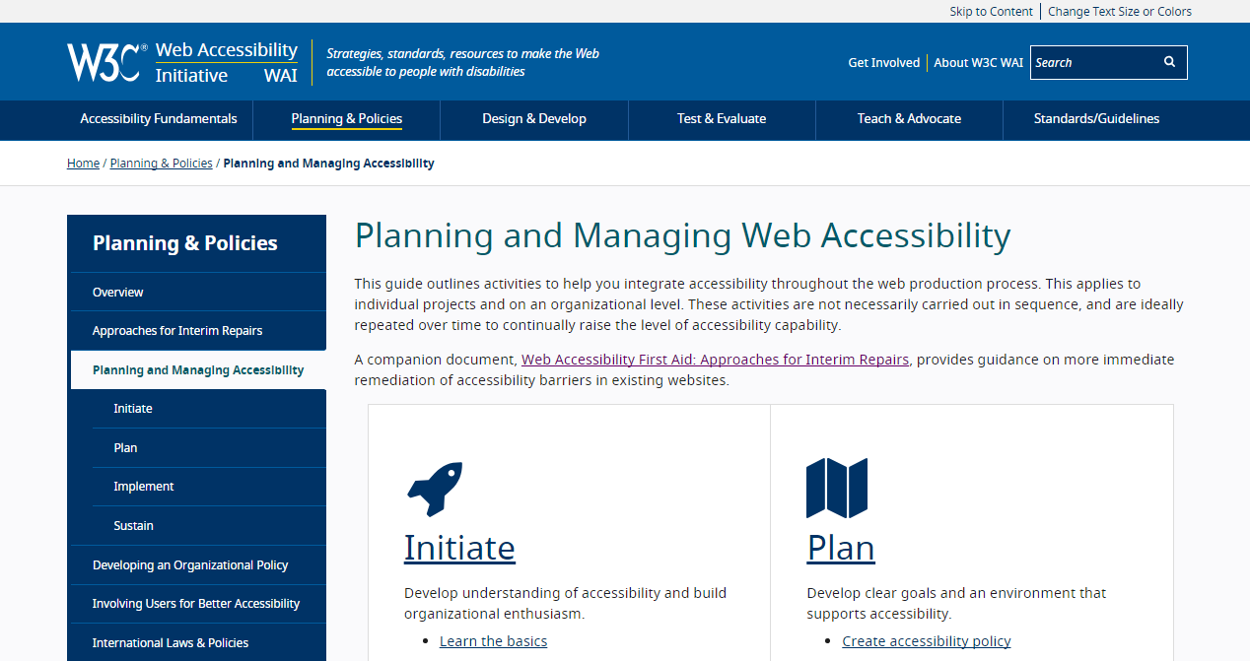
What Resources are
Available for Me?
WAI Web Site: www.w3.org/WAI

Slide 25
Get Involved with WAI
Be part of community that develops guidelines
Stay in tune with evolving standards:
  WCAG 2
  WCAG 2.1
  Silver
Ensure accessibility remains priority

Slide 26
Join In!
Getting WAI Announcements
Mailing list: www.w3.org/WAI/IG/
Twitter: w3c_wai
RSS feed
WAI Interest Group (IG)
GitHub

Slide 27

Thank You
Brent Bakken
brent.bakken@pearson.com

